Slide 1
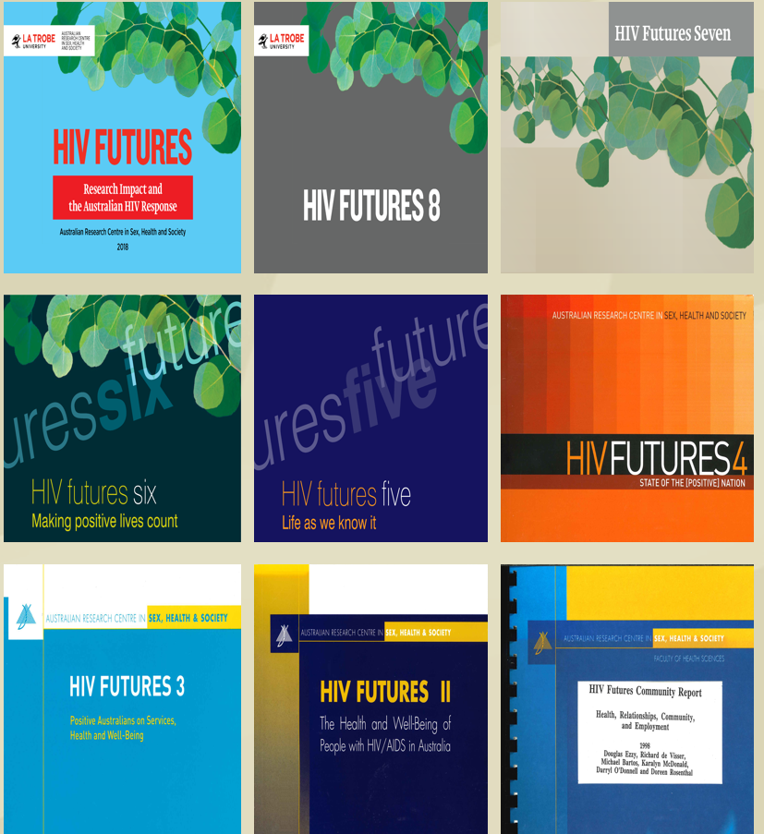
HIV Futures 10 Quality of life among people living with HIV in Australia in 2022
HIV Futures is a repeated cross-sectional survey on quality of life among people living with HIV that has been running since 1997
HIV Futures 10 just released
Data were collected for HIV Futures 10 from May 2021 until July 2022 using an online survey or hardcopy survey booklet.
The survey looks at quality of life, financial security, health, wellbeing, treatment, support, sex, relationships, HIV-related stigma, COVID-19, telehealth and substance use

Slide 2
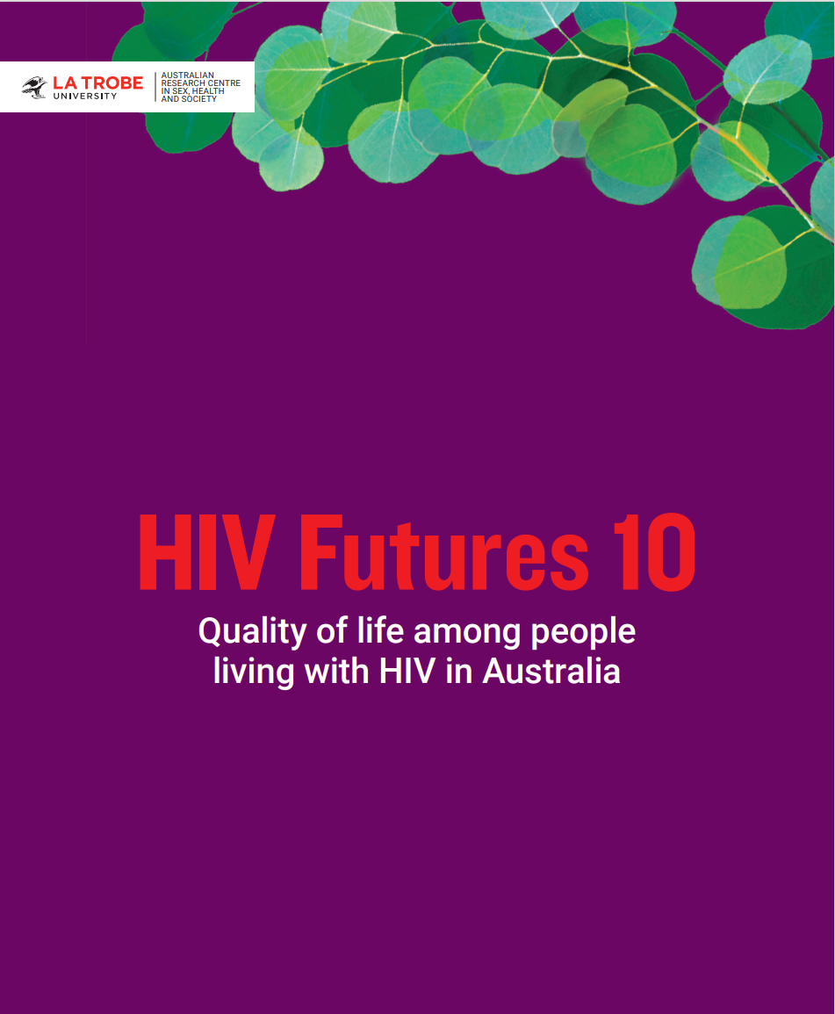
‘At a glance’: notable findings from HIV Futures 10
816 people living with HIV from all states and territories of Australia completed the HIV Futures 10 survey
71.8% reported ‘good’ quality of life, which is approaching the Australian National HIV Strategy target of 75%
Factors associated with lower quality of life include: financial insecurity, lower social connection (which may be related to stigma), poorer physical health and living in a remote/regional area
A substantial number of people living with HIV live in poverty and rely on social security
Even though uptake of ART is high (98%), participants reported ambivalence and uncertainty about side-effects and harm from long-term ART use.
The number of participants who see benefit in being, or who would like to be, connected with a community of people living with HIV currently outweighs the number of participants who feel they are connected to this community
There is an ongoing need to promote leadership within the HIV sector of people from diverse communities

Slide 3
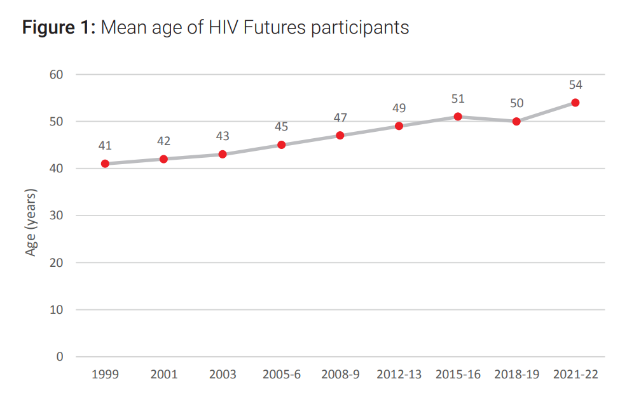
Participant characteristics
There were 816 participants in HIV Futures 10
88.7% identified as men/male; 9.6% as women/female, including five transgender women; 1.4% as non-binary or gender fluid
86.5% were cisgender men who identified as gay, consistent with the population of PLHIV in Australia
The average and median age was 54 years, the average age of women was lower, at 48 years
2.8% were Aboriginal and/or Torres Strait Islander
56.1% lived in inner city or outer suburban areas
57.6% were in the paid workforce, working either full-time, part-time or casual hours

Slide 4
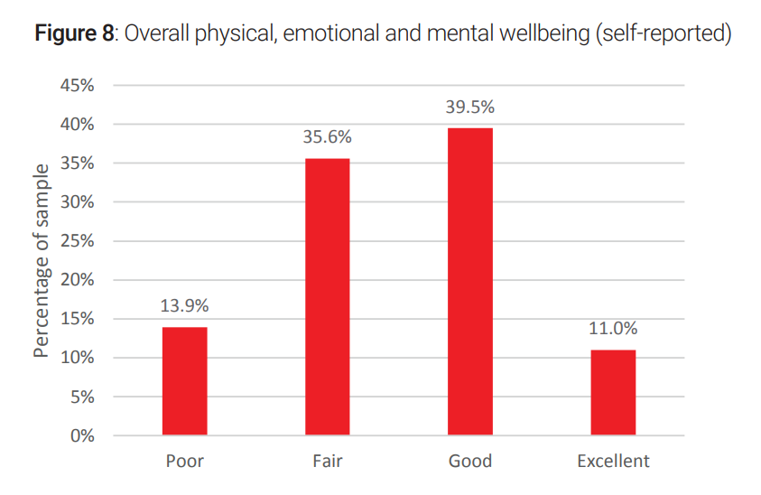
Quality of life
71.8% of participants reported they had ‘good’ QoL using a PozQoL score of 3.0 or higher, from a range of 1-5 in which higher scores indicate better QoL
Percent reporting ‘good’ QoL was 63.1% in 2018-19
50.5% reported their overall wellbeing (including physical, emotional and mental wellbeing) to be ‘good’ or ‘excellent’
Factors associated with better QoL included: Higher income, no recent financial stress, living in inner city areas, better general health, a greater level of social connectedness, living with a partner/spouse, and not perceiving COVID-19 pandemic to have had a significant impact on wellbeing
People in the 65+ age bracket were significantly more likely to report higher QoL than those in other age brackets

Slide 5
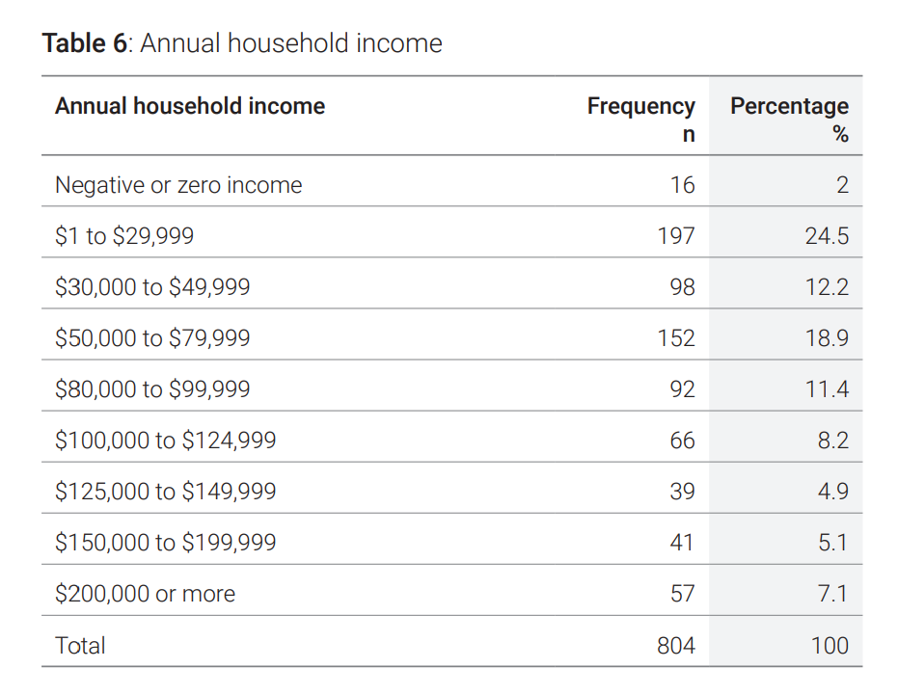
Financial and housing security
26.5% reported an annual household income of less than $30,000
30.3% reported their main source of income to be social security (including a pension, disability pension or other government benefits)
4.7% indicated they had not taken HIV medication at least once in the last 12 months due to financial reasons
29.5% indicated that it was ‘somewhat’ or ‘very’ difficult to access medication for financial reasons
17.9% indicated it was ‘somewhat’ or ‘very’ difficult to access healthcare for financial reasons

Slide 6
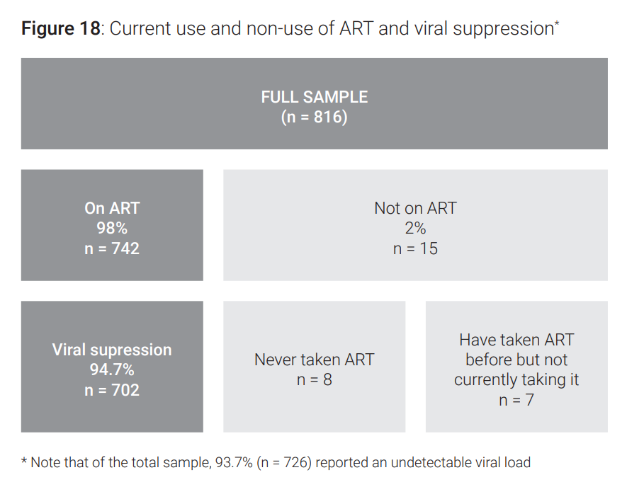
HIV diagnosis and treatment
The majority of participants had been diagnosed with HIV within 2 years of having acquired the virus, although women were significantly more likely than men to have been diagnosed 2 or more years after they acquired HIV.
98% were currently taking antiretroviral therapy (ART)
94.7% of those on ART reported an undetectable viral load (viral suppression) as of their most recent test
81% were happy with their current ART, and 79% found it convenient
40.9% indicated some dissatisfaction with side effects from ART

Slide 7
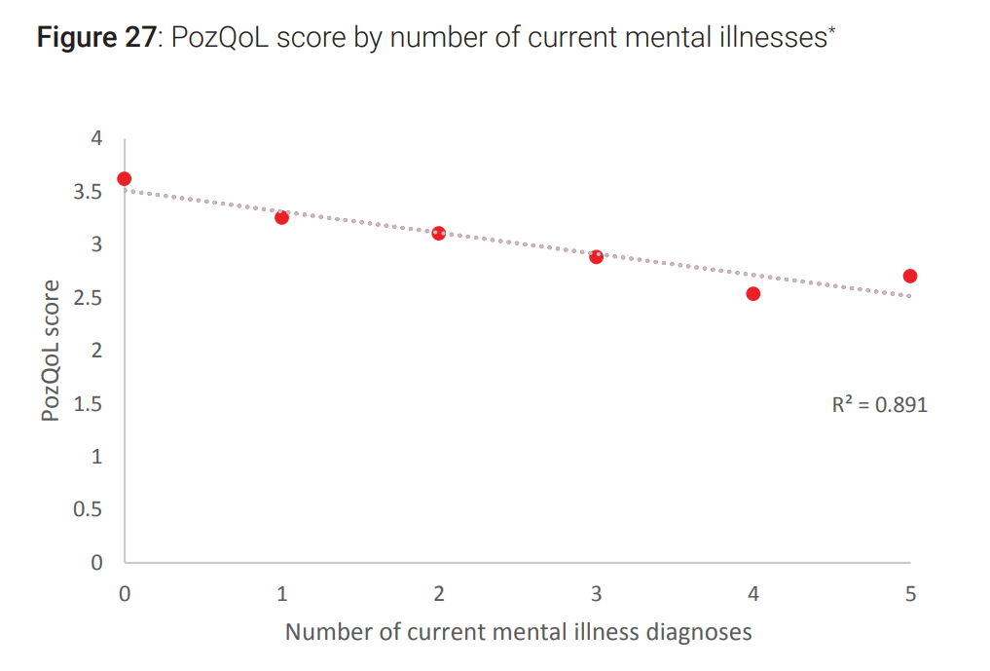
Mental health
33.1% reported a current or past diagnosis of depression
30.4% reported a current or past diagnosis of anxiety conditions
35.8% had a current diagnosis of more than one mental health conditions
Mental health diagnoses was associated with poorer QoL

Slide 8
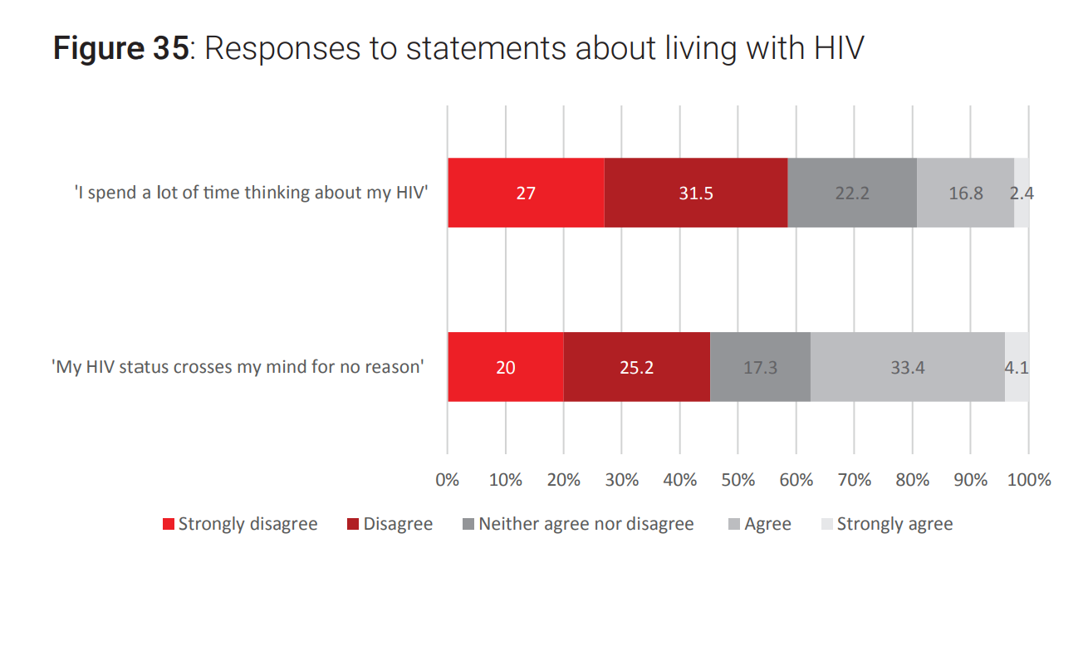
Stigma and discrimination
36.6% reported at least one experience of HIV-related stigma or discrimination in the past 12 months
29.8% reported that they had been treated differently by a healthcare worker due to their HIV in the past 12 months
One in five (20%) agreed that they spent a lot of time thinking about their HIV

Slide 9
Social connection
43.5% of participants live alone. This will not lead to social isolation or loneliness for everyone, but as a general trend it is associated with lower social connectedness.
52.4% were single (not in a current relationship). As a general trend, cohabiting with a partner does appear to be a buffer against social disconnection.
People living alone are more likely to have a lower income: 26.5% reported an annual income of less than $30,000, 69% of these people were living alone.
Not being in the paid workforce can be associated with lower social connection.
Greater social connectedness was associated with higher income, less financial stress and living with a partner/spouse.

Slide 10
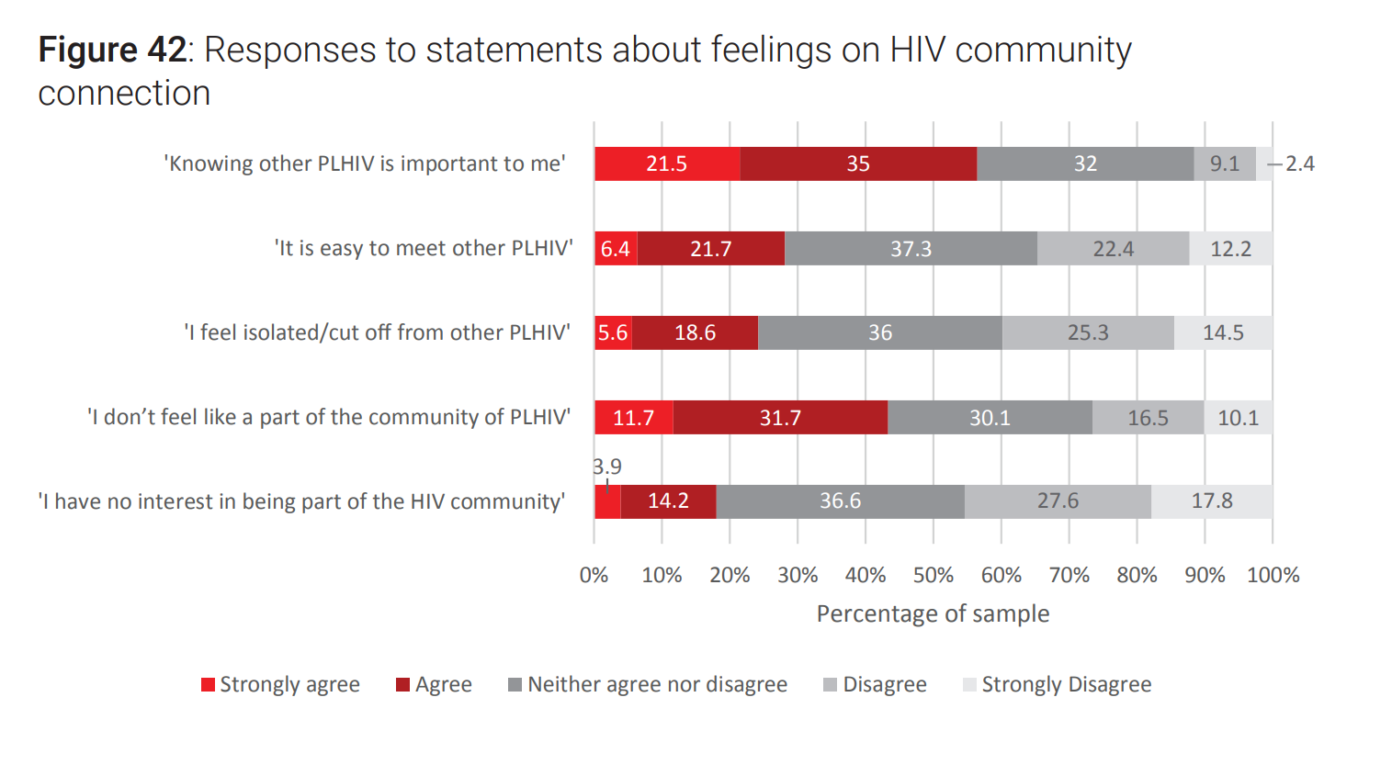
Peer connection
42.3% indicated they did not have any other PLHIV in their social/informal networks who they could talk to about HIV
56.5% agreed that knowing other PLHIV was important to them
54.6% were interested in being part of an HIV community
However:
73.4% did not feel like part of a community of PLHIV
34.6% felt it was hard to meet other PLHIV
24.2% felt isolated or cut off from other PLHIV

Slide 11
Peer support services
In the past 12 months:
25.1% had accessed advice or support from a peer worker
21.5% had participated in an online forum or network for PLHIV
13.3% had participated in a peer support program or workshop
9.7% had used a peer navigator programs
People who had been diagnosed with HIV in the past 5 years were more likely to have accessed peer navigator programs

Slide 12
QoL among Asian-born gay and bisexual men
Qualitative (interview) study component of HIV Futures 10
Peer interviews conducted with 8 Asian born GBM who are living with HIV and with 10 advocates/educators who work with these populations
Findings:
Migration, particularly waiting for a visa outcome, can leave people in ‘limbo’, which can limit people’s ability to plan their future, develop their career or build social networks.
HIV makes the process of obtaining a permanent visa less certain and more complex. It can also leave people more vulnerable to judgement, stigma and unwanted disclosure of their HIV status in the migration/visa process.
Interview participants described the ways that uncertainty association with the combined impact of migration and HIV sometimes left them feeling anxious and vulnerable and, for some, lonely and isolated.
Despite this, participants described personal resources, skills and strengths that helped them manage uncertainty and stress. For some, this was augmented by HIV support services and peer networks, although there is a need for services led by people with migration experiences.
"I’ve met service providers who are lovely people, they just don’t realise that as a person of colour there are more barriers for me to actually access services that I need, or actually just be able to feel safe.“
"Coming from South Asia or Asian cultures – when you are not open about your sexuality with your family or the society at large – now you are also not really sure if you want to open up about your HIV diagnosis with your dear friends and friends in the LGBT circle as well. So that definitely creates a bit of a – like, you hide things from people, so already you’re used to hiding things from the larger society, and now it also hides certain aspects of your life from the gay society of friends as well [as the people] that you live with or hang out with."

Slide 13
HIV Futures 10 Full report
Citation:
Norman, T., Power, J., Rule, J., Chen, J., & Bourne., A. (2022). HIV Futures 10: Quality of life among people living with HIV in Australia (monograph series number 134). Australian Research Centre in Sex, Health and Society, La Trobe University. doi: 10.26181/21397641
Download from:
www.hivfutures.org.au
Contact:
hivfutures@latrobe.edu.au

Slide 14
Acknowledgments
The success of the HIV response is built on the continued insight, effort and persistence of people living with HIV. This project relied on input from people living with HIV at all stages of the study process.
We are grateful to all participants in HIV Futures 10 and mindful of the time and effort it takes for people to complete the survey questionnaire.
A range of peer-based organisations and HIV advocacy/community agencies from every state and territory of Australia have been actively involved in this project, providing guidance on the survey instrument, facilitating participation through their membership and community networks, and advising on analysis and priorities for this report. This includes ACON, Thorne Harbour Health, Meridian ACT, NTAHC, WAAC, Positive Life NSW, Living Positive Victoria, Queensland Positive People, Positive Life SA, The Institute of Many (TIM) and many other agencies and individuals.
The project is officially endorsed, and supported, by the National Association of People with HIV Australia (NAPWHA), the Australian Federation of AIDS Organisations (AFAO), and the Australasian Society for HIV, Viral Hepatitis and Sexual Health Medicine (ASHM).
The project is funded by the Australian Government Department of Health and run by the Australian Research Centre in Sex, Health and Society (ARCSHS), based at La Trobe University in Melbourne.

