Slide 1
Research
Data Management
2022
Notes:
https://doi.org/10.26181/5e5c41c9f1dde – Slides on OPAL
https://doi.org/10.26181/5f18f93caed88 – research data best practices collection

Slide 2
Overview
What is research data management?
Your data lifecycle
Support
Principles
Tools

Slide 3
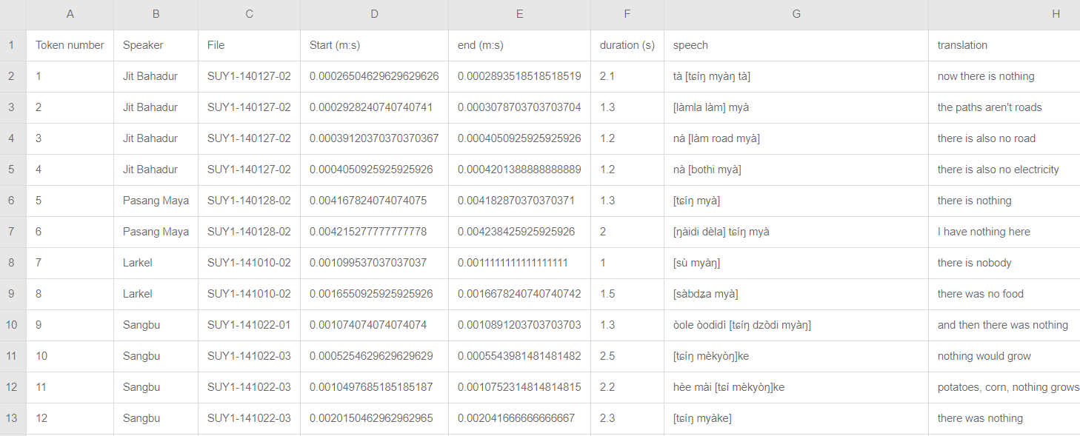
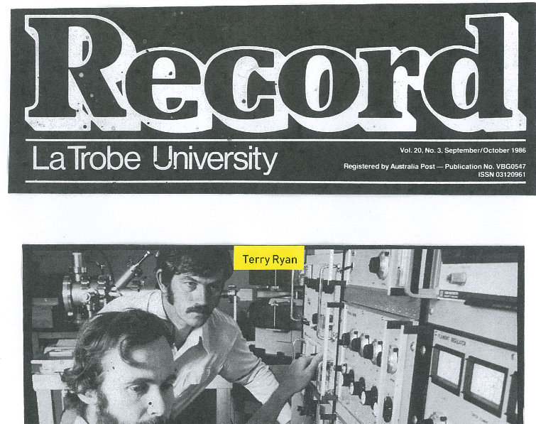
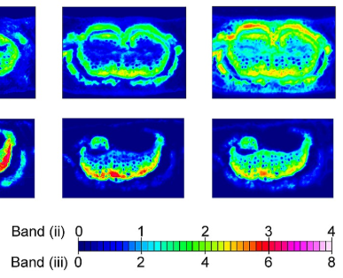
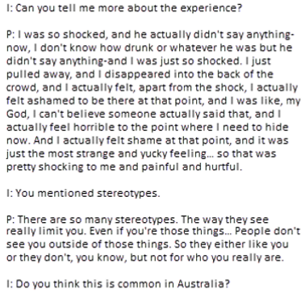
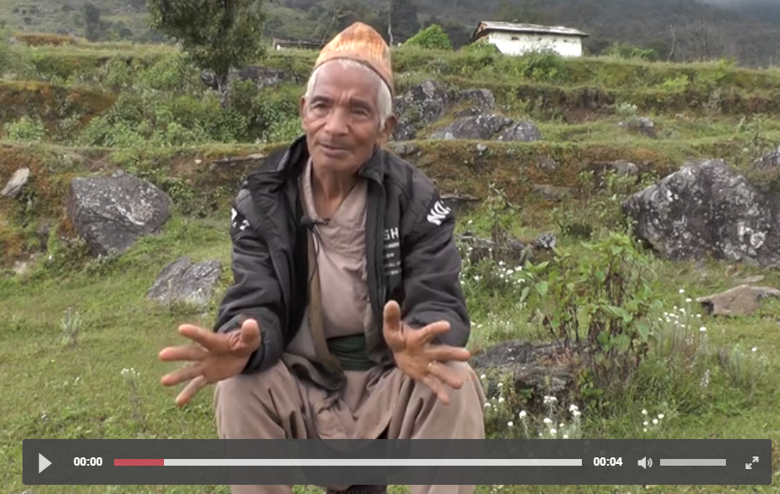
What is research data?

Slide 4
Ethics applications
Grant applications
What is a
research data management plan?
Planning at the start of your project will
Be organised & systematic to save time
Prevent issues before they become problems
Minimise the risks of data catastrophes
Plan your data practices in line with best practices
La Trobe: https://policies.latrobe.edu.au/document/view.php?id=106
NHMRC: https://www.nhmrc.gov.au/guidelines-publications/r41

Slide 5
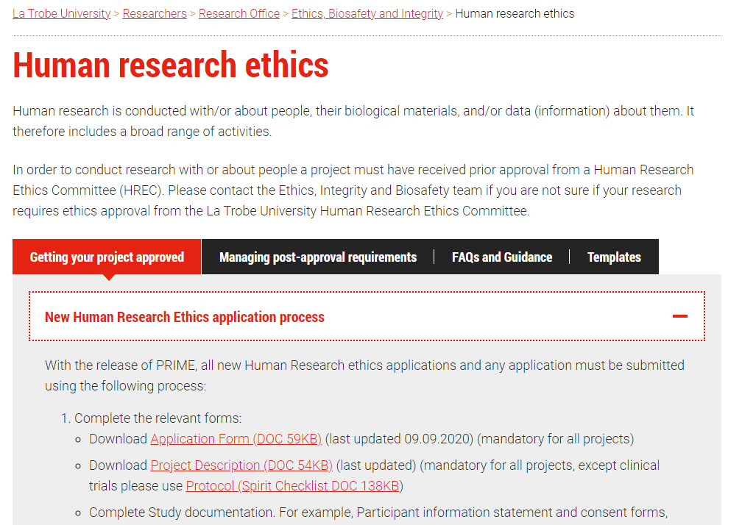
https://www.latrobe.edu.au/researchers/research-office/ethics/human-ethics

Slide 6
https://www.latrobe.edu.au/researchers/research-office/ethics/human-ethics

Slide 7
The data lifecycle
Gathering
Analysis
Visualisation
Sharing
Secure transfer
Open access
Working Storage
Destruction
Reintegration
Archive storage
commons.wikimedia.org/wiki/Data lifecycle.svg, Thomas Shafee, CC BY

Slide 8
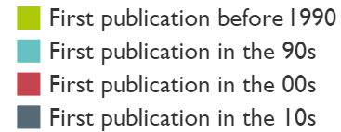
Safe storage
Tools & Support
CloudStor
Research drive
Online Research Notebook
Working Storage
Principles
Multiple redundant backups
Organisation & description
Version management
Automation
Location

Slide 9
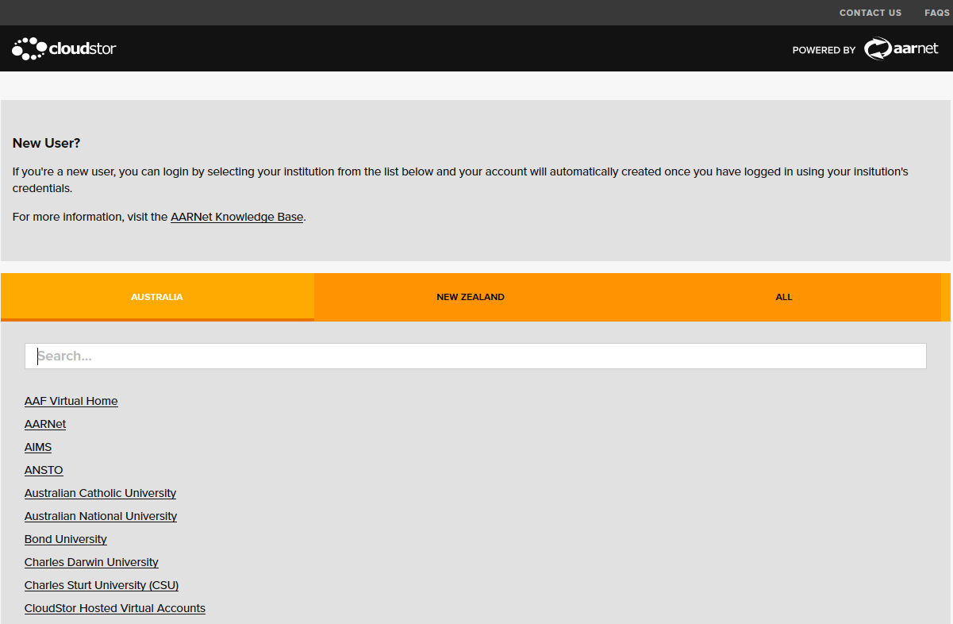
Accessing CloudStor
https://cloudstor.aarnet.edu.au
Notes:
After clicking on log in → select your institution

Slide 10
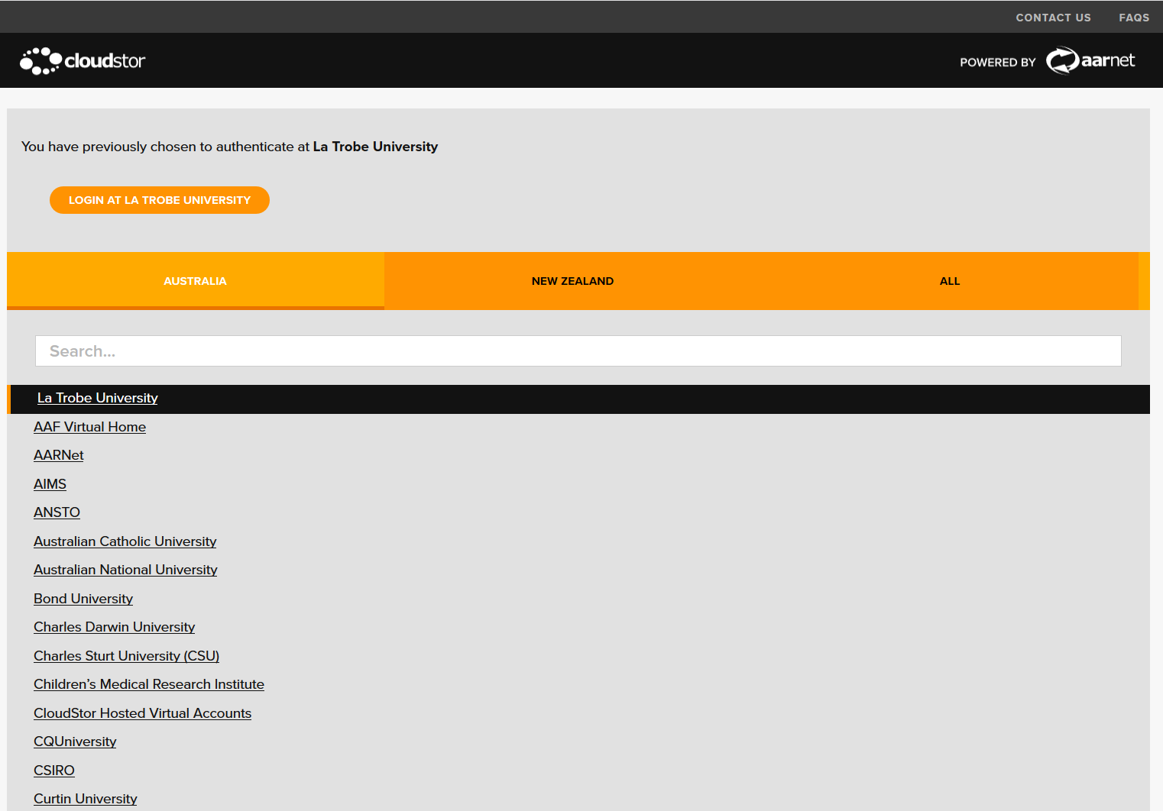
Accessing CloudStor
https://cloudstor.aarnet.edu.au
Notes:
If you have logged in previously, the authentication should still be available, so not having to search again

Slide 11
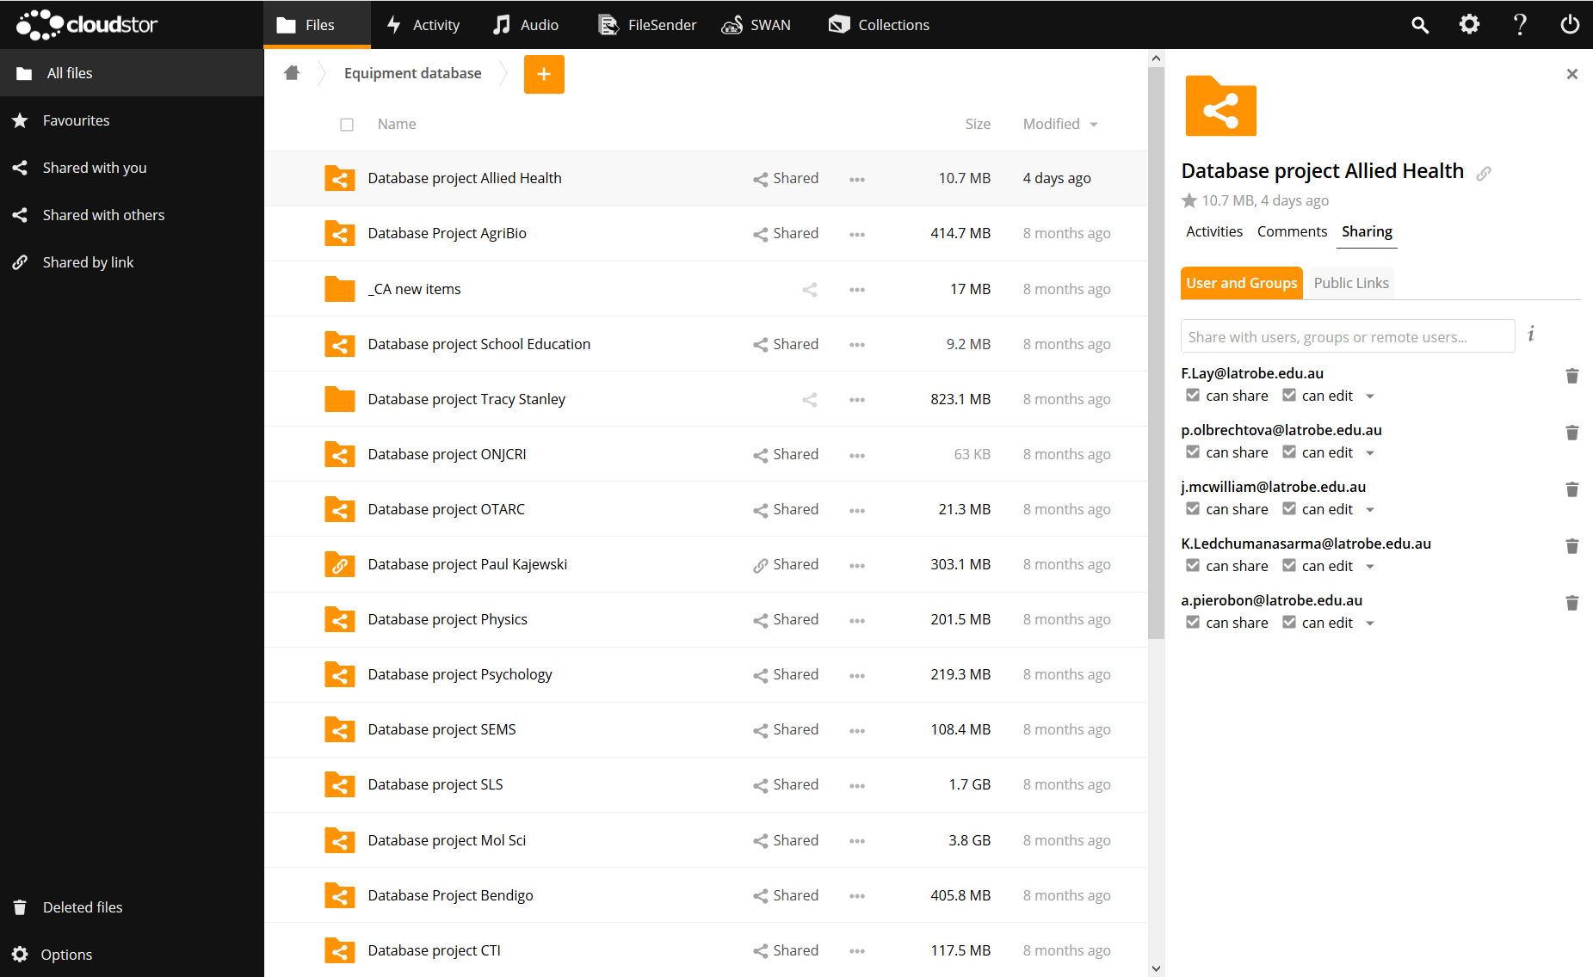
Accessing CloudStor
https://cloudstor.aarnet.edu.au

Slide 12
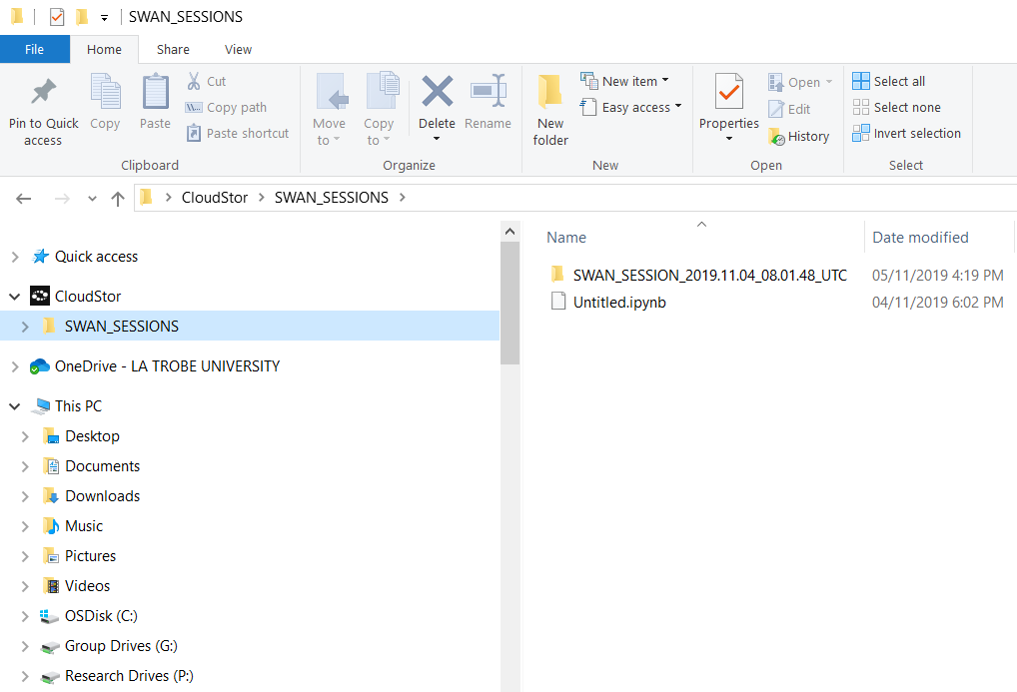
Accessing CloudStor
https://cloudstor.aarnet.edu.au

Slide 13
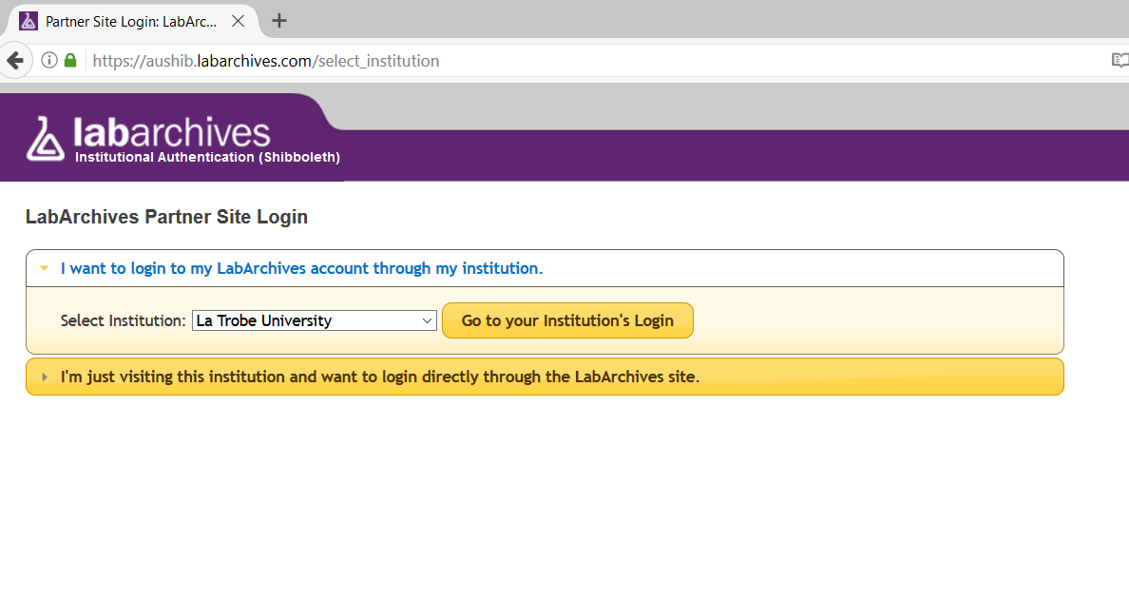
Accessing Online Research Notebook
https://aushib.labarchives.com
Office of Research Infrastructure

Slide 14
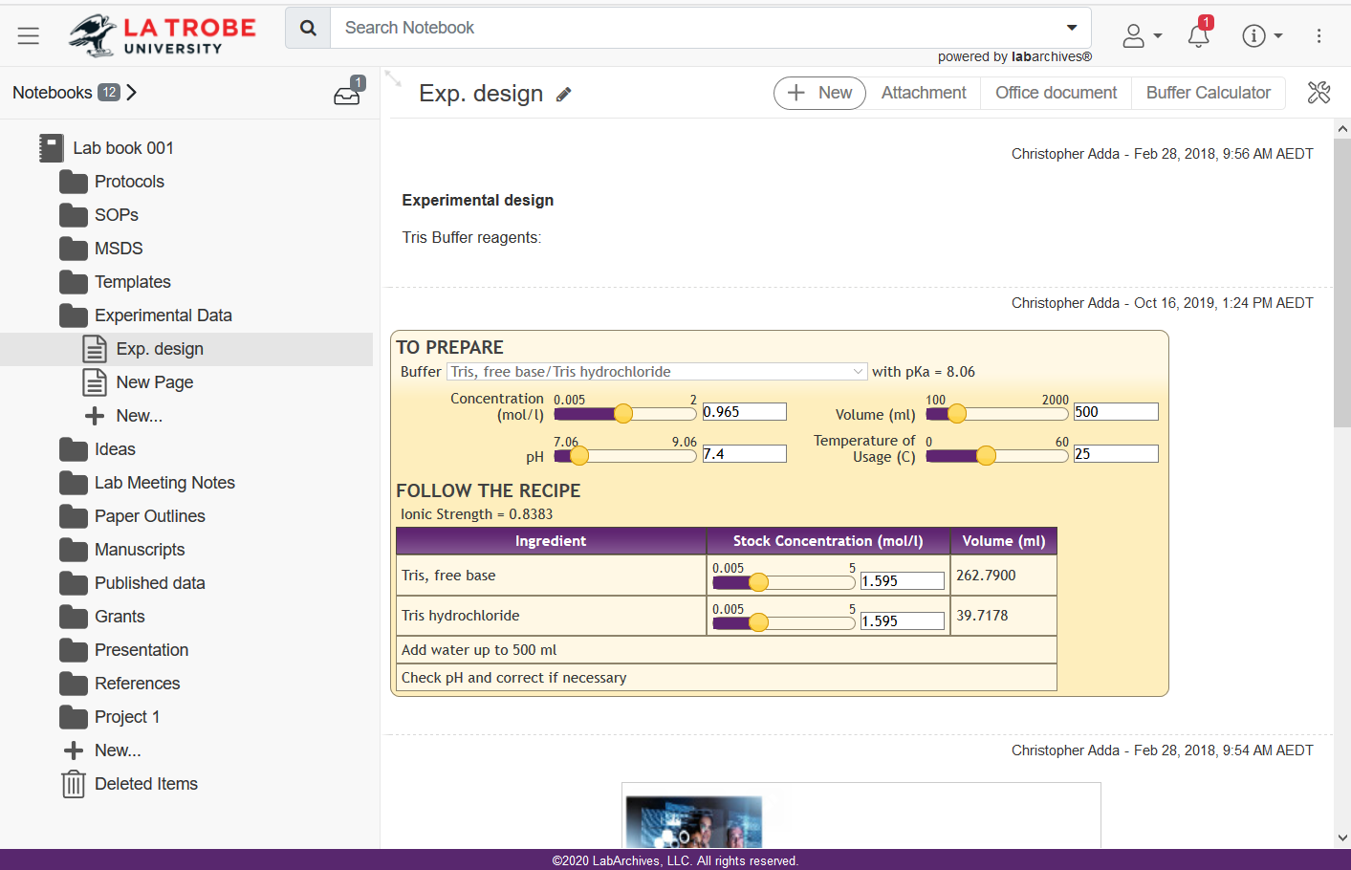
Accessing Online Research Notebook
https://aushib.labarchives.com
Office of Research Infrastructure

Slide 15
Tidy storage
Tools & Support
CloudStor
Research drive
Online Research Notebook
Data carpentry
Working Storage
Principles
Tidy data
Organisation & description
files & folders
rows & columns
datasets & collections
Version management
Automation
Untidy data is valueless
Imagine your future self or colleagues in 10 years trying to find and understand your data. What would you need to know?
Context
Meaning of fields
Nature of measurements
Data methodologies
Timestamps or dates
Why the dataset/collection is valuable
This is all metadata: the data that makes your data make sense

Slide 16
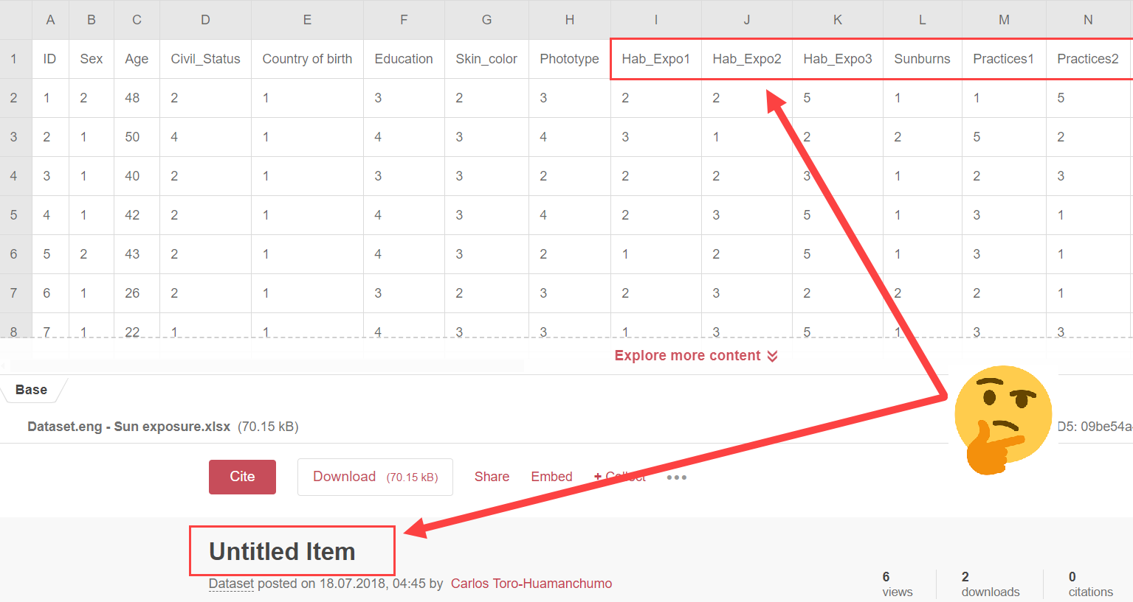
Tidy storage

Slide 17
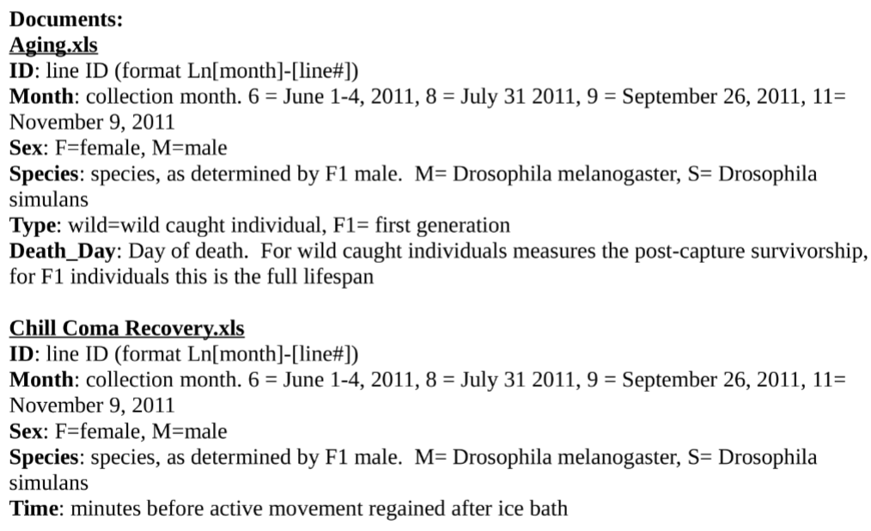
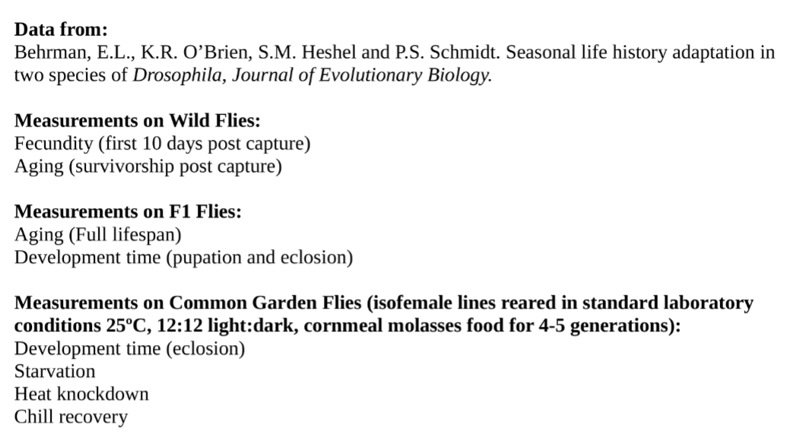
Tidy storage
L. Behrman, Emily; Watson, Samuel S.; R. O'Brien, Katherine; Heschel, Shane M.; S. Schmidt, Paul (2015): metadata. figshare. Paper. https://doi.org/10.5061/dryad.2j48p/7

Slide 18
Data sensitivity
Tools & Support
CloudStor
Research drive
Online Research Notebook
Working Storage
Principles
Encryption at rest
Encryption in transit
De-identification of personal information
Store re-identification codes separate from data
“Sensitive data are data that can be used to identify an individual, species, object, or location that introduces a risk of discrimination, harm, or unwanted attention.” - Australian Research Data Commons
How identifiable is your data?
What are your ethical responsibilities as a researcher?
Who has ownership or rights over the data?
What grant/contract conditions and mandates do you have to comply with?
What consent is there for future use?

Slide 19
Data sensitivity examples
 | Sensitive | Not Sensitive
Human | Audio/video recordings of individuals or focus groups Patient records Information that personally identifies a participant Addresses, contact details, location, or other Personally Identifiable Information (PII) Information that would otherwise cause harm to the reputation or welfare of an individual if divulged Mandated confidentiality by external partners Research into indigenous culture/society, or involving participants from the indigenous community | Anonymous survey with no potential content that could identify users De-identified datasets for a large participant population Publicly available datasets Previous research literature Research on subjects of broad historical, political or social interest
Non-Human | Research undertaken as part of a commercial/partnership arrangement with other entities having strict non-disclosure, intellectual property or in-confidence requirements Research funded by commonwealth, state or third-party entities where strict confidentially is required Research into endangered species | Research involving animals, plants, chemical or material subjects Research on subjects of broad historical, political or social interest

Slide 20
Anonymisation may not be enough
Name | Age | Previous country of residence | Most recent date of entry | Current address | IP address
#0923485 | 34 | Japan | 2020-01-12 | 1 Green St, Bundoora | 140.134.209.234
#6506544 | 60 | Russia | 2018-04-06 | 2 Gold Rd, Gardenvale | 111.040.280.616
#6745859 | 59 | Peru | 2019-12-24 | 3 Blue Dr, St Kilda | 065.968.234.185
Anonymising
“I pled guilty in federal court to felonies for the benefit of, at the direction of, and in coordination with Individual 1”
“Individual 1 […] began an ultimately successful campaign for President of the United States.”
- Michael Cohen
Notes:
Creating a non-sensitive data set - considerations
Anonymisation – removing personally identifying information.
Example above, can see that the names have been assigned a unique identifier, but all other information remains unchanged.
All of the remaining information can be pieced together to identify the participant.

Slide 21
Deidentification methods
Name | Age | Previous country of residence | Most recent date of entry | Current address | IP address
#0923485 | 34 30-39 | Japan | 2020-01-12 2020-02-10 | 1 Green St, Bundoora | 140.134.209.234 omitted
#6506544 | 60 60-69 | Russia | 2018-04-06 2018-04-04 | 2 Gold Rd, Gardenvale | 111.040.280.616 omitted
#6745859 | 59 50-59 | Peru | 2019-12-24 2020-01-03 | 3 Blue Dr, St Kilda | 065.968.234.185 omitted
Anonymising
Rounding
Random noise
Grouping
Omission
Log and describe the changes made to the deidentified dataset
Name: anonymized to a unique identifier
Age: grouped from age year to age decade
Prev country: no changes made to raw data
Date of entry: random noise added, normal distribution, st. dev. = 50 days
Current address: grouped from street address to suburb
IP address: omitted
Notes:
Here are some examples of deidentification methods, and changes made to the data set to prevent identification.
Any methods of deidentification used on the dataset do need to be logged and described

Slide 22
Deidentification considerations
Name | Age | Previous country of residence | Most recent date of entry | Current address | IP address
#0923485 | 34 30-39 | Japan Asia | 2020-01-12 2020-01-13 | 1 Green St, Bundoora | 140.134.209.234 140.134.209.***
#6506544 | 60 60-69 | Russia Asia | 2018-04-06 2018-04-06 | 2 Gold Rd, Gardenvale | 111.040.280.616 111.040.280.***
#6745859 | 59 50-59 | Peru S. America | 2019-12-24 2019-12-22 | 3 Blue Dr, St Kilda | 065.968.234.185 065.968.234.***
Anonymising
Rounding
Random noise
Grouping
Omission
E.g. Age: Would random noise preserve the data structure better (continuous vs categorical)
E.g. Country: Does large grouping lose too much information or predicted uses by others?
E.g. Entry date: Is there enough noise? Consider the standard deviation of your data.
E.g. Address: Group size variation? Gardenvale only has 900 ppl but Bundoora has 29,000
E.g. IP : Does this type of de-identification prevent reversal (including if combined with other data)?
Transcripts: De-identification while retaining analytic utility of the record is often particularly difficult
https://managing-qualitative-data.org/modules/3/b/

Slide 23
Sharing metadata only
Perhaps the dataset is so sensitive that de-identification cannot be performed without making the whole thing meaningless (e.g. unstructured data).
Summarise what the dataset contains, and whether/how to apply for access
Data fields
Name
Age
Previous country of residence
Most recent date of entry
Current address
IP address
Data description
1500 entries
Collected during 2018
Inclusion criteria of XYZ
Procedure for accessing raw data
Contact authors
Describe intended usage
May be forwarded to LTU ethics committee for approval?
Notes:
Metadata description of the previous example.
What data was collected and recorded?
How many entries are there, when was the data collected, and what was the inclusion criteria that was used?
Is there a method available to share the data, or for another party to access it? – if there is, this needs to be described

Slide 24
Transcript redaction
Principles
Avoid ‘blacked out’ redaction
Replace with altered or summary information
Keep linkages intact by applying pseudonyms, aggregate nouns, and categories consistently
Clearly indicate altered sections
Document the list of de-identification rules, both for yourself, or for your team should you collaborate
Category
Replacement pseudonyms
My father, [Michael Rosenzweig], was Jewish and my mother, [Maria Kelly], was Irish Catholic.
My mother went to [a girls high school] in South Philadelphia. My father went to [a co-ed high school in South Philadelphia], and then went to Penn on a [sports] scholarship. [description of his role on the team]. He thought he may have been one of the first Jews to play in the Ivy League.
Aggregate noun
Broad descriptive summary
Adapted from : https://managing-qualitative-data.org/modules/3/b
under a CC BY-SA license. This slide is therefore also CC BY-SA licensed.

Slide 25
Judgement calls & transparency
Data interactions affect de-identification
Stronger deidentification of one field may allow less deidentification of another
Combination with public data might re-identify
Need to know which data to prioritise to preserve integrity
Need to be transparent (especially when data is altered!)
What has been changed?
What has been omitted?
Is there a process to be granted access to the original raw dataset?
Principles
Match deidentification method and level to data type
Fully document process
Re-identification keys are as sensitive as the full raw data
Common fields to consider
Name
DOB
Address
Profession
Location/postcode
Ethnicity
Education level
Safely sharing sensitive data, ANDS
ands.org.au/working-with-data/sensitive-data/sharing-sensitive-data
Guidelines and advice: De-identification and the Privacy Act, Australian government
oaic.gov.au/privacy/guidance-and-advice/de-identification-and-the-privacy-act/

Slide 26
Data gathering
The data, information, collections & references needed for the research
Tools & Support
RedCAP
QuestionPro
Web scraping
Systematic reviews
Literature searching
Human data
(e.g. Surveys & questionnaires)
Experiment
data
Working Storage
Published data
Principles
Full workflow record
Encryption in transit
Integrated with storage
Integrated with analysis

Slide 27
Analysis and visualisation
Inspection, transformation, modelling & statistics
Intuitive representation of complex information
Tools & Support
Training
Excel
[R], python
Digital research drop-ins
Statistics platform
Centre for data analytics
VisLabs
3D printing
Gathering
Analysis
Visualisation
Working Storage
Principles
Automation
Reproducibility
Check assumptions
Specify uncertainty
Tufte’s rules for graphics
Reintegration
https://oaic.gov.au/privacy/guidance-and-advice/guide-to-data-analytics-and-the-australian-privacy-principles/

Slide 28
The fate of data
What is your intended data legacy?
Gathering
Analysis
Visualisation
Sharing
Secure transfer
Open access
Working Storage
Destruction
Reintegration
Archive storage

Slide 29
Safe sharing
Is this data
sensitive?
yes
no
Store sensitive data securely
Share full data openly
then
Can a
non-sensitive version be
created?
yes
no
Share de-identified version of data openly
Share metadata openly
Secure: CloudStor, P Drive, Online research notebook (LabArchive) etc
Open: OPAL (Figshare), OSF etc
Neither: Laptop, USB, dropbox, researchgate etc
Notes:
Is this data sensitive?
No – share full data openly
Yes – Store securely
Can non-sensitive version be created?
No – share metadata openly
Yes – share de-identified version openly
OPAL (Open @ LaTrobe) OSF (Open Science Framework)

Slide 30
Archiving
Tools & Support
CloudStor
Research drive
Online Research Notebook
“As a general rule, research data and primary materials must be retained for sufficient time to allow reference to them by other researchers and for as long as interest and discussion persist following publication.” - La Trobe University Research Data Management Policy
Principles
Multiple redundant backups
Mandated retention
5 years General research data
Materials / specimens
7 years Research with any health information
Consent forms
HDR data
15 years Clinical trial data & documentation
also until all participants turn 25 if any was <18
Permanent Human ethics documents
Patent data & documentation
Research collaborative agreements
Research outcomes or reports of high or significant regulatory public interest
Destruction
Archive storage
Records and Archives Services must authorize destruction records@latrobe.edu.au
Public Record Office Victoria document PROS 07/01 & PROS 16/08

Slide 31
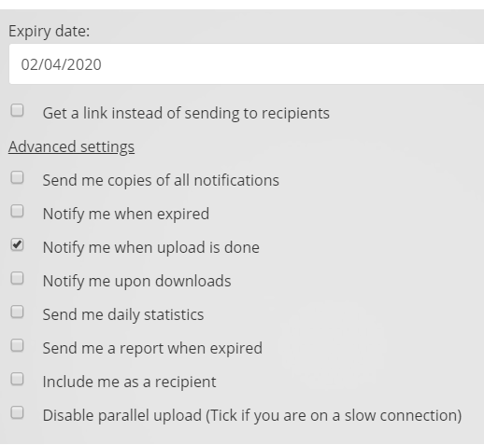
Sharing secure data
Tools & Support
CloudStor
Online Research Notebook
Sharing
Secure transfer
Principles
Encryption in transit
Integrated with storage
Specificity
One recipient or many?
One-off or ongoing?
Domestic or overseas?
Send / receive / both?

Slide 32
Sharing open data
Tools & Support
opal.latrobe.edu.au
Raw data, processed data, collections, methods, scripts, images, publications, presentations, posters, books, supplementary data, stand-alone data
Sharing
Benefits you:
Citation advantage
Upload your publications for 30-800% more citations
Upload associated datasets for 20-60% more citations
Increase the visibility of otherwise hidden work
Often mandated by journals (e.g. PLOS, Nature)
Now mandated by funders
Open access
Principles
Share what’s safe
Full data?
De-identified data?
Metadata only?
Metadata makes it usable
Benefits the research community:
Accessibility to research and teachers and students, or researchers from lower and middle income countries
FAIR : Findable, Accessible, Interoperable, Reusable
Replication, reuse, integration, knowledge equity

Slide 33
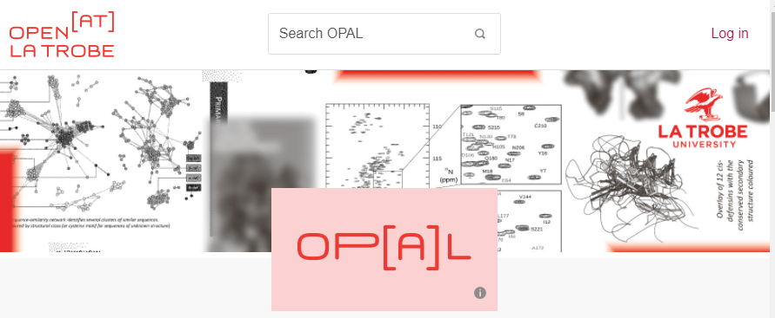
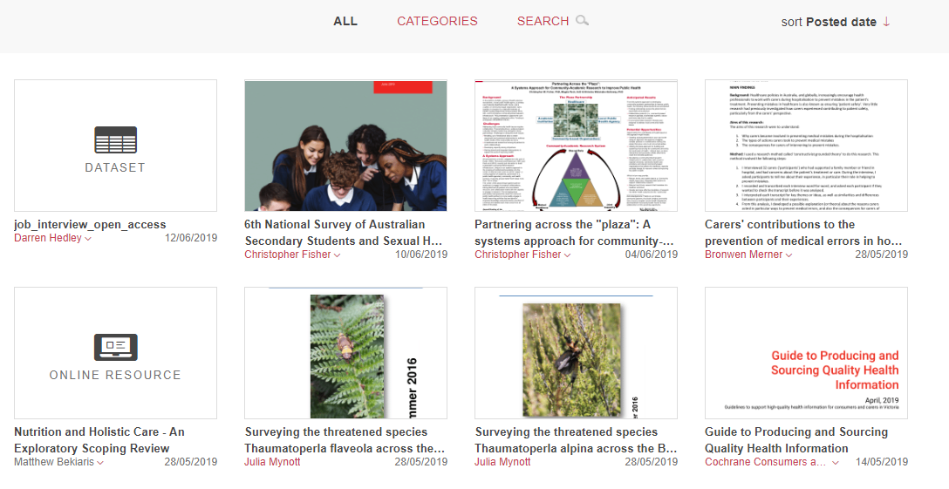
opal.latrobe.edu.au
Open at La Trobe - University Repository

Slide 34
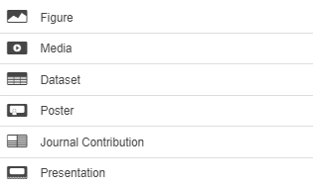
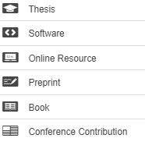
opal.latrobe.edu.au
Open publications
Open theses
Open data
Open education res.

Slide 35
opal.latrobe.edu.au
Open publications
Postprints of all
published articles*
Open theses
Any preprints
Copies of your gold
OA journal articles
All PhD theses*
Collections
(images, letters, items)
Masters theses
Open data
Anything presented
at a conference
Supplementary data*
Lecture material
eBureau
Stand-alone datasets
Open education res.
Negative results
Textbooks
* Compulsory
https://www.nhmrc.gov.au/about-us/resources/open-access-policy
https://www.arc.gov.au/policies-strategies/policy/arc-open-access-policy
https://policies.latrobe.edu.au/document/view.php?id=293

Slide 36
Rounds of drafting
& informal feedback
Preprint
Can always be shared in a green OA repository at any time
Work in progress
Submitted version
Submitted to journal
Peer review
Author corrections
Open publications
Can always be shared in a green OA repository after accepted by journal (sometimes after embargo)
Postprint
Author-accepted
manuscript (AAM)
Copy-edited
Typeset
Formatted
http://sherpa.ac.uk/romeo/search.php
Published
Can usually only be shared if published by a gold OA or hybrid journal
Version of record
PDF / HTML / XML
DOI from journal
commons.wikimedia.org/wiki/File:Preprint_postprint_published.png, Thomas Shafee, CC BY

Slide 37
The data lifecycle
Gathering
Analysis
Visualisation
Sharing
Secure transfer
Open access
Working Storage
Destruction
Reintegration
Archive storage
commons.wikimedia.org/wiki/Data lifecycle.svg, Thomas Shafee, CC BY

Slide 38
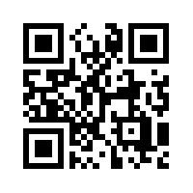
Thank
doi.org/10.26181/5e5c41c9f1dde
you
Digital Research Drop-in
2nd Tuesday of the month 3-4pm
Computer program use
Coding and scripting
Digital research
Analysis & Visualisation ideas
latrobe.edu.au/research-infrastructure/digital-research/training-and-events/drop-in
latrobe.libguides.com/dataready
libraryresearchsupport@latrobe.edu.au
Notes:
latrobe.edu.au/research-infrastructure/digital-research/training-and-events/drop-in

Slide 39
Data @ La Trobe
Gathering
Analysis
Visualisation
Sharing
The data, information, collections & references needed for the research
Inspection, transformation, modelling & statistics
Intuitive representation of complex information
Dissemination, reproducibility, reuse
Secure transfer
Surveys & questionnaires
(RedCAP | QuestionPro)
Colleagues, collaborators, participants
(CloudStor | LabArchive)
Experiments
Open access
Full OA journal publication (Gold OA)
La Trobe OPAL Repository (Green OA)
Working Storage
(CloudStor | Research drive | LabArchive)
(Publications | Theses | Data | Education resources)
Your previous datasets
e.g. datasets, collections, posters, presentations
Published information and data
Destruction
Reintegration
Archiving
(5, 7, or 15 years)

