Slide 1
Figshare
as La Trobe’s
OA one-stop-shop
Research Publications
Research Data
Education Resources
Theses
Special Collections
Scholarly Publications team
Research Partnerships team
Notes:
I would like to acknowledge the Wurundjuri people who are the traditional owners of the land on which we are located today. We acknowledge their elders past, present and emerging, and acknowledge the important part that indigenous culture plays in our everyday lives.

Slide 2
Aims for the uploading user: increase uptake
How did
LTU compare?
(2014 data)
 | Gold | Green
World | 17% ^{[1]} | 7% ^{[1]}
Australia | 10% ^{[2]} | 9% ^{[3]}
LTU | 14% ^{[2]} | <1% ^{[4]}
Priority 1:
User-friendly interface
Priority 2:
Clear information
[1] S Haustein "The state of OA: a large-scale analysis of the prevalence and impact of Open Access articles". PeerJ (2016) 6: e4375. DOI:10.7717/peerj.4375.
[2] Web of Science
[3] http://roar.eprints.org/view/geoname/geoname=5F2=5FAU.html *2013 data
[4] http://arrow.latrobe.edu.au:8080/vital/access/manager/Index
Notes:
OA is slow moving in Australia, so aiming to get ahead of the curve (rather than fix it later) also LTU reputation positioning
Looking to expand into more OER stuff
Good looking user interface (user friendly)
Unified / One-stop-shop / centralised

Slide 3
Aims for the admins: increase integration
Data Repository
Priority 3:
Integration with other systems
Publication Repository
National Reporting
Priority 4:
Reporting and metrics
User Profiles
Research assessment
Open textbook materials
Notes:
Metrics (e.g. download stats)
Reporting
Integration

Slide 4
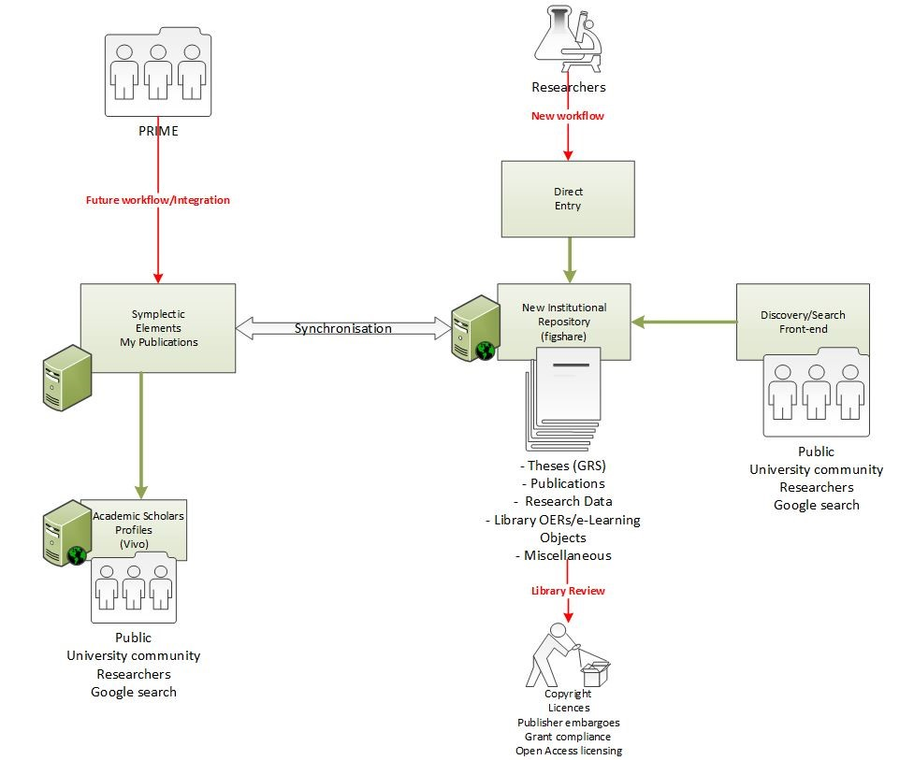
Implementation (technical)
The most important aspect: crosswalks
Group & subgroup structure lets you customise metadata (not item type
Separate publication vs data uploads
Group structure (quite unique structure)
Research Publications
Theses
Research Data
Special Collections
Education Resources
Notes:
Crosswalking – using group & subgroup structure
Group lets you customise metadata (not item type)
Don’t get hung up on items types!
Testing the X-walks took the most time (even simple things like mandatory item or minor field name differences)
Being clear on what ppl you need on what level to make decisions
Inclusion/exclusion criteria

Slide 5
Implementation
(rollout and comms)
Extensive combined-arms comms
News, emails, social media, individual consults…
Dedicated outreach
OPAL launch in OA week (obvs.)
Departmental seminars (specialised to context)
Embedding into other outreach
Research data management
Data sensitivity
Choosing a journal
Publication metrics
Impact, profile and social media presence
Principles
Researcher/user focus
Carrot before stick
Face-to-face and tailored
Unified OA solution
Notes:
OPAL is our new multi-purpose repo
User-friendly
Integrated with e.g. MyPublications and Profiles
Indexed
One-stop-shop
Consolidates and greatly extends capabilities of old repositories (Arrow ResearchOnline and Researchdata.latrobe)

Slide 6
Benefits of OA to LTU and its researchers
Citation advantage
Publications
Metrics
Grants
Knowledge transfer
Reputation
H index
Funding
Continued employment
Uni ERA ranks
Upload publications for + 30-800% citations ^{[1]}
Upload datasets for + 20-60% more citations ^{[2]}
Increase visibility and exposure
Reach
Engagement
Impact
Readership
Viewership
Downloads
Cites
Shares
‘Real world’ effect / change
Worldwide Researchers, Public,
Policymakers, Practitioners, Journalists
Mandated by funders & journals
How does
LTU compare?
(2014 data)
 | Gold | Green
World | 17% ^{[5]} | 7% ^{[5]}
Australia | 10% ^{[6]} | 9% ^{[7]}
LTU | 14% ^{[6]} | <1% ^{[8]}
Metadata
open within
3 months ^{[3,4]}
...
Text & data
open within
12 months ^{[3,4]}
[1] E McKiernan, et al. "Point of view: How open science helps researchers succeed.“
Elife 5 (2016): e16800. doi.org/10.7554/eLife.16800
[2] H Piwowar, et al. “Data reuse and the open data citation advantage.”
PeerJ (2013) doi:10.7717/peerj.175.
[3] https://www.nhmrc.gov.au/about-us/resources/open-access-policy
[4] https://www.arc.gov.au/policies-strategies/policy/arc-open-access-policy
[5] S Haustein "The state of OA: a large-scale analysis of the prevalence and impact of Open Access articles". PeerJ (2016) 6: e4375. DOI:10.7717/peerj.4375.
[6] Web of Science
[7] http://roar.eprints.org/view/geoname/geoname=5F2=5FAU.html *2013 data
[8] http://arrow.latrobe.edu.au:8080/vital/access/manager/Index
Notes:
Most obvious is citation advantage:
consider effect on individual grant competitiveness and university rankings
Also quantified:
Readership online and PDF downloads
Social media engagement (twitter)
Sourcing in Wikipedia!
Broader exposure and engagement boosts ‘real-world impact’
Industry / medicine / policy etc
Compliance issue!
LTU compliance is dismal: 15% as of 2014
NHMRC : peer-reviewed journal articles & conf papers
ARC : all research outputs of any kind

Slide 7
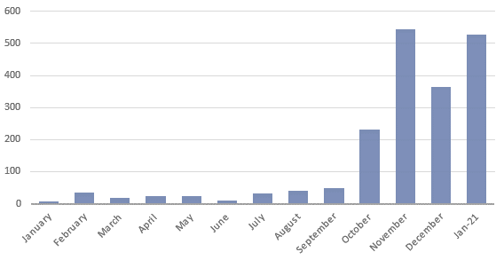
Uptake and successes
Opportunity to re-engage researchers about practical open scholarship
Rapid increase in publication uploads
High diversity of other uploads
3-minute thesis videos
Infographics
Grant applications
Podcasts
Additional unified look and branding
OPAL launch
OA week
Notes:
+Ves =
Comparatively easy to use (e.g. metadata fields)
Symplectic integration – for users v. simple
Pretty interface and we also put some effort into look and branding
Evidence , number of uploads
For users, unified one-stop-shop

Slide 8
Opportunities for improvement
Improve visual customization/autonomy
Ability to include both open version and closed version of item
Greater ability to customise the landing page, static front page that requires vendor intervention to update.
Increase tagging and annotation tools for admins
Particularly for the review queue: customized views, bulk assign publications to a reviewer etc
Further tools for published items
Allow for preferred names for authors
Retroactively apply embargos if errors found
Non-semantic keyword tagging system
e.g. ‘mRNA’ ‘messenger RNA’ and ‘messenger-RNA’ all separate
Extend automation features
Automatically accept link-only items that point to an OA publisher’s DOIs
Improve features for emailing users (e.g. single-click ‘you uploaded the published version. Send us your postprint/AAM’)
Notes:
‘’what we would like” / Opportunities for improvements / Challenges etc

Slide 9
Alignment with LTU cultural values
LTU
Accountable
Care
Innovative
Transparency
Reproducibility
Connected
Collaboration maximisation
Future of academia
Knoweldsge equity
Content sharing
Research efficiency
Impact maximisation
Output reusability
Interoperability
Free exchange
Accessibility
Broader strategy:
Positioning La Trobe as Australia’s leading Open Access university
Notes:
Linked in to broader Open strategy at LTU
OERs as a tool to get to zero $ textbook costs
Plan-S preparedness
IP and research practice policy updates (including open source software, code and data)
Visualise your Thesis and similar competitions
Building on LTU’s reputation and brand for
outward-facing
future-facing
being a bit radical
Library key player in multi-departmental process inc.:
Library
Research Office
Graduate Research School
Academic Departments

Slide 10
Part of a wider activity set
Open code and software
Linked open data
LTU
OA week
OERs as a tool to get to 0 $ textbook costs
IP and research policy updates
Plan-S preparedness
Special collections
Visualise your thesis competition
Wiki CoP
Notes:
Linked in to broader Open strategy at LTU
OERs as a tool to get to zero $ textbook costs
Plan-S preparedness
IP and research practice policy updates (including open source software, code and data)
Visualise your Thesis and similar competitions
Building on LTU’s reputation and brand for
outward-facing
future-facing
being a bit radical
Library key player in multi-departmental process inc.:
Library
Research Office
Graduate Research School
Academic Departments

Slide 11
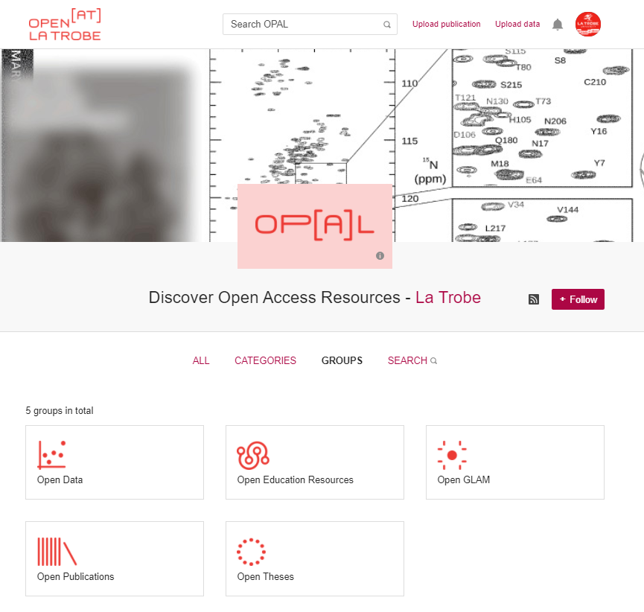
[end]
Contact details:
repository@latrobe.edu.au
https://opal.latrobe.edu.au

