Slide 1
Publishing Open Educational Resources and Scholarly Outputs in Creative Arts & English
Steven Chang | Coordinator, Digital Literacies and Open Education (Library)
Thomas Shafee | Senior Officer, Research Data Outputs (Library)
Clare O’Hanlon | Senior Library Learning Advisor (Library)
This presentation is sharable and reusable: CC BY 4.0

Slide 2
Background
The future of the book
Print → electronic revolution
COVID-19 impact and opportunities
Open education resources
Open scholarship

Slide 3
Background: Print to Electronic revolution
Print
Electronic
Free to read
Artificial scarcity
Open
Restricted usage
Strict limitations
Knowledge equity
Expensive
Paywalled
Access isn’t enough
Equity ?
e.g. How Fiction Works
Co-creation
Beyond reading -> read-write!
SC
Notes:
Last 30 years we’ve been through a slow, tentative, and incomplete Print to Electronic revolution
Future of the book – what happened to that utopian dream?
DRM happened
Artificial scarcity happened
More things are increasingly free to read – ABC comparison. You can’t do anything else with it than passively consume.
We should aim high and aspire to “true open access” and the five Rs – where resources become dynamic sites of engagement, not just something you read.
But there is a tension between idealism and pragmatism.
Our pragmatist position at LTU: Zero Textbook Costs for students. Regardless of whether that involves library subscriptions to DRM-protected resources, DRM-free resources, or “true open access” resources. In reality it will be some combination of these.

Slide 4
Background: COVID-19 crisis
Open Education Resources
Broader open scholarship
Social distancing – print access challenges
Quarantining (of print books!)
Rapid move to online teaching
Golden opportunity for advancing open textbooks
Time to rethink the promise of digital education altogether
Unemployment crisis
Textbook affordability
Almost all publishers release COVID research ‘openly’
Many not true OA, just free to read
arbitrary amount of time as decided by publisher
‘COVID-relevance’ decided by publisher
Highlights relevance of open data
E.g. linking datasets on infection rates, legal codes, viral genomes
SC TS
Notes:
COVID-19 is a chance to go back to the question of what was and is the original promise of digital education
Optimism in the 90s about the promise of instant, digital, affordable access to education as well as new ways of engaging students where they have an interactive/co-creative relationship with learning resources rather than being passive recipients
In many ways we've fallen short of the promise - there are still barriers to equity, to access, to engaging students
The new COVID world is a double edged sword
Sharpens existing inequities and barriers
e.g. social distancing and the Library, and student unemployment crisis
conversely, sudden transition to online forces us to rethink digital learning and do it better
A lot of the unsolved dilemmas come down to licensing. We can solve this with OEP.

Slide 5
Overview: what is open scholarship?
Principles
Applications
Wherever possible:
Give freedom for others to use, share and adapt resources
Maximise transparency and accountability
Clearly license rights and requirements
Open Education Resources
Knowledge equity
Cost reductions
Academic publications
Individual reach and impact
Maximise efficiency of scholarly corpus
Data, code, collections
Reproducibility
Supporting, and enriched information
Meta-analysis & integration
Also theses, performance assessment, strategy, decision making, accounting
Findable
Interoperable
Accessible
Reusable
Wilkinson, Mark D., et al. "The FAIR Guiding Principles for scientific data management and stewardship." Scientific data 3.1 (2016): 1-9.
TS
Notes:
But principles can apply as wide as transparent criteria for performance assessment (e.g. DORA), strategy and decision making, Open-book accounting, etc.

Slide 6
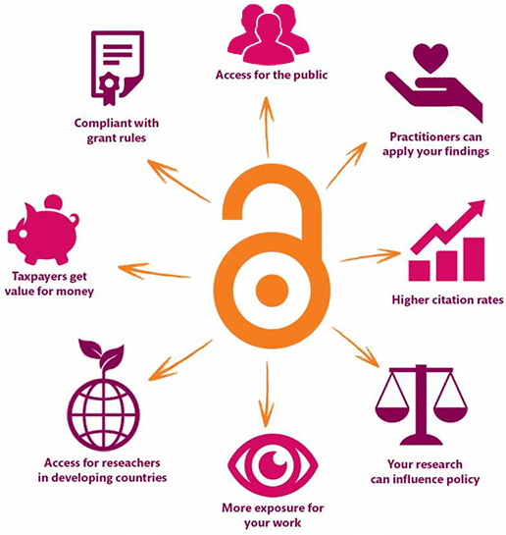
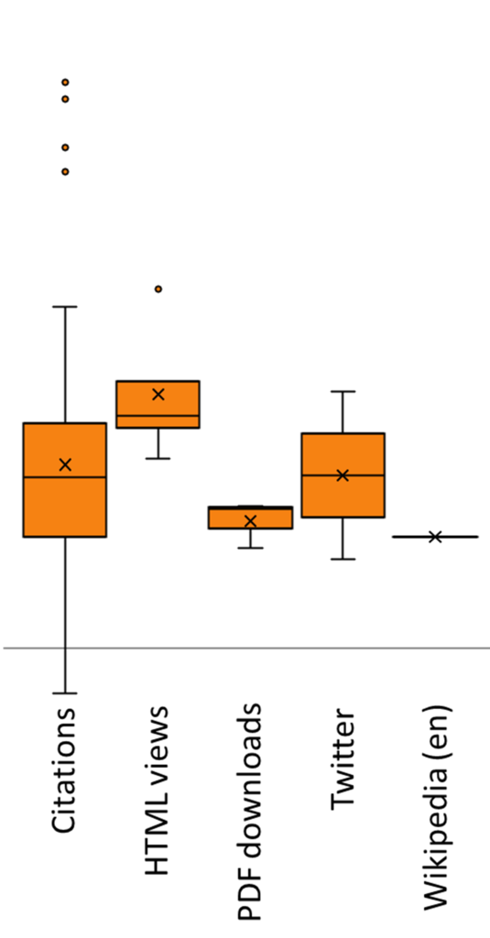
Benefits of open outputs
What's in it for me?
10x
3x
OA:non-OA citation ratio
1x
Img: Danny Kingsley & Sarah Brown, CC BY
TS
commons.wikimedia.org/wiki/File:Open_access_citation_advantage.png, Thomas Shafee, CC BY

Slide 7
Open scholarship in
Creative Arts & Humanities
"Our purpose is to use the power of the Internet to share feminist knowledge for free and to inspire social action. Our conversation with digital media professionals outside the academy prompted us to imagine a feminist resource friendly to a generation whose access to information comes to them from their mobile phones, and at the same time, to offer direction toward more complex, detailed information available in books. Now, multimodality as a formal concern is part of the theory, or the thinking, behind Equality Archive as a feminist tool for critical consciousness and social action that is infinitely scalable"
Eversley, S & Hurson, L 2017, 'Equality Archive: Open Educational Resources as Feminist Praxis http://equalityarchive.com/', Feminist Media Histories, Vol. 3, No.3, pp. 154–158.
Uptake not as high as in science, technology and medicine, but is growing
La Trobe CAE open scholarship links: Screening the past, The Looking Glass, and Writing From Below
>200 OA journals in the Directory of Open Access Journals (DOAJ), including:
Journal for Artistic Research
Comics Grid: Journal of Comics Scholarship
Digital Medievalist
Some open repositories e.g:
Humanities Commons
Open Humanities Press
Open Library of Humanities
CO
Notes:
There are a variety of reasons why uptake isn't as high in Creative arts and humanities as it is in science, technology and medicine – and models for open scholarship and education don't always quite fit Creative arts and humanities as much as they could – creative arts and humanities often blur the lines between research and teaching a little more and don't rely on one single prescribed textbook as much.
A nice legacy of open scholarship connected to CAE that make me (Clare) proud to work with you and that we can build on.
This open education as feminist praxis article and quote captures why I am passionate about open education and I thought it may resonate with you too

Slide 8
The crisis: equity in education
When textbook costs are approaching, Ms Dove eats canned tuna to save money.
"I budget by buying non perishables and cooking really, really cheap food. If you're living out of home you already have bills, rent and other living costs," the 21-year-old said.
"I'm living from paycheck to paycheck.“
Why are textbooks so expensive in Australia?
SC

Slide 9
Overview: what is an OER?
“OER are teaching, learning, and research resources that reside in the public domain or have been released under an intellectual property license that permits their free use and re-purposing by others. Open educational resources include full courses, course materials, modules, textbooks, streaming videos, tests, software, and any other tools, materials, or techniques used to support access to knowledge.”
The William and Flora Hewlett Foundation
Read-only culture read-write culture.
SC
Notes:
What can I do with this thing?
An OER says: many things! Go for it – as long as your use adheres to the activities permitted by the license.
A traditional commercial learning resource says: here is a long list of things you cannot do with this resource. A whole world of possibilities is ruled out a priori, by the terms of restrictive commercial licenses.
OER comes in many forms…

Slide 10
Benefits of OER
Reduce costs
Cost of education is a key barrier to equitable learning. OER levels the playing field.
Innovation
Opens new ways of learning and teaching through co-creation, participatory student engagement rather than passive consumption
Save time
Don’t reinvent the wheel! Adapt, customise, and localise existing content to suit your course
Lifelong learning
Students can freely use resources after graduation in their workplaces and communities
Efficiency
Rapid circulation & currency at scale. Keep pace with the changing world.
SC
Notes:
Levelling the playing field is profound. Access to education means access to knowledge, which means access to agency, access to means of change to improve society from different perspective.
But it's not just all about costs. It's about new ways of learning altogether.
Avoid reinventing the wheel. Millions of educators. Adapt existing open material, then localise it.
Lifelong learning - we don't stop learning just because we've graduated. Revisiting past lessons.
Highly adaptable in a changing world. When mega-events like COVID and GFC drop, you can instantly update content as a user/reader.
Read-write relationship. Not read-only.

Slide 11
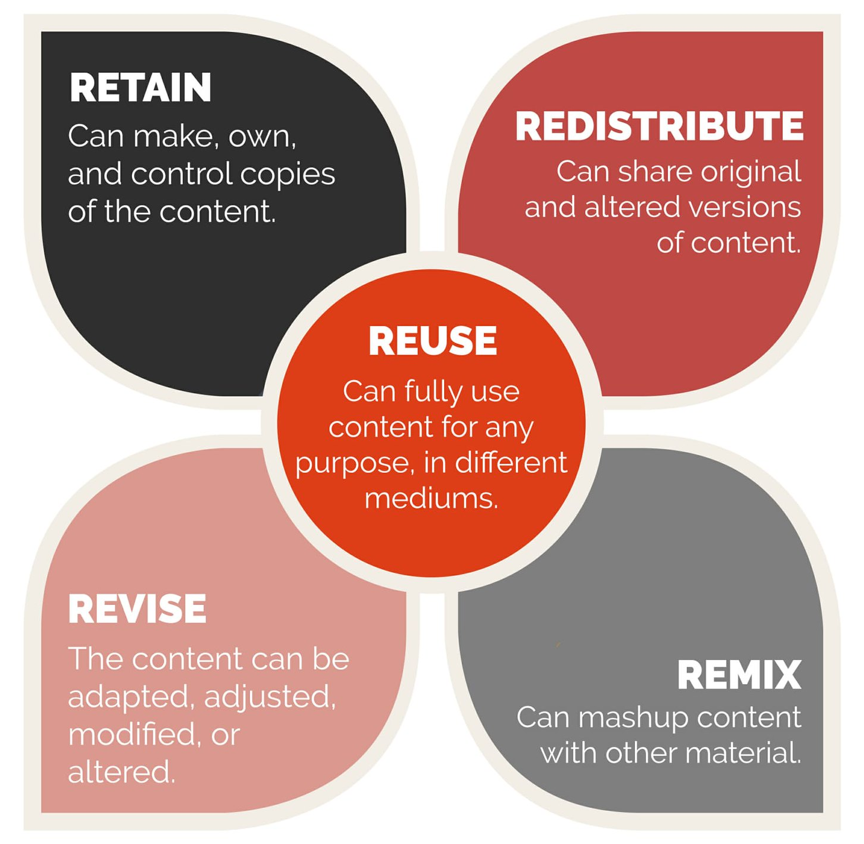
Beyond open access
Findable
Interoperable
Accessible
Reusable
Img: https://www.flickr.com/photos/ellenmetter/37631415622 Ellen September, CC BY
SC
Notes:
A common mistake librarians make is to narrowly focus on “open access” only.
Firstly, open access means little to anyone except people who are already converts.
But…open access as means to what? What is the “so what”?
The answer you give here is the key to persuading stakeholders, but also thinking about why we're doing it, how do we get value out of it.
One bridge between open access and So What is FAIR/the Five Rs
e.g. Download an American open textbook chapter, adapt and edit it to contextualise it from an Australian perspective, and then remix it with your own authored chapters into comparative law open textbook of your own. Share with your students and Americans!

Slide 12
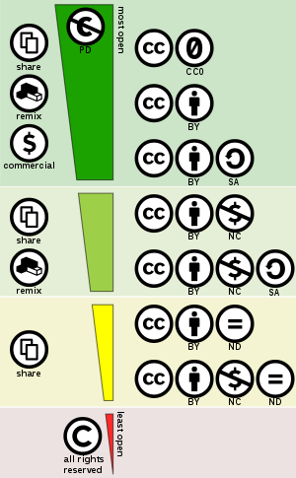
Creative Commons
Creative Commons licensing is the engine of Open publishing
Clear usage rights:
Share : copy and redistribute the material in any medium or format
Adapt : remix, transform, and build upon the material for any purpose
Clear requirements:
Attribute : You must give appropriate credit, provide a link to the license, and indicate if changes were made. You may do so in any reasonable manner, but not in any way that suggests the licensor endorses you or your use.
Enables use at scale without seeking case-by-case permissions
https://creativecommons.org/licenses/by/4.0/
Img: commons.wikimedia.org/wiki/File:Creative_commons_license_spectrum.svg, Shaddim, CC BY
TS
Notes:
CC licensing is the tool

Slide 13
Putting into practice

Slide 14
Where to find OER
Textbooks:
Open Textbook Library
OpenStax
BCCampus open textbooks
Federated search: search everything open!
MERLOT
OER Commons
Mason OER MetaFinder
Audio-visual
Creative Commons Search
Pixabay
State Library of Victoria Digital Image Pool
Free Music Archive
Open datasets:
Research Data Australia
Figshare
SC

Slide 15
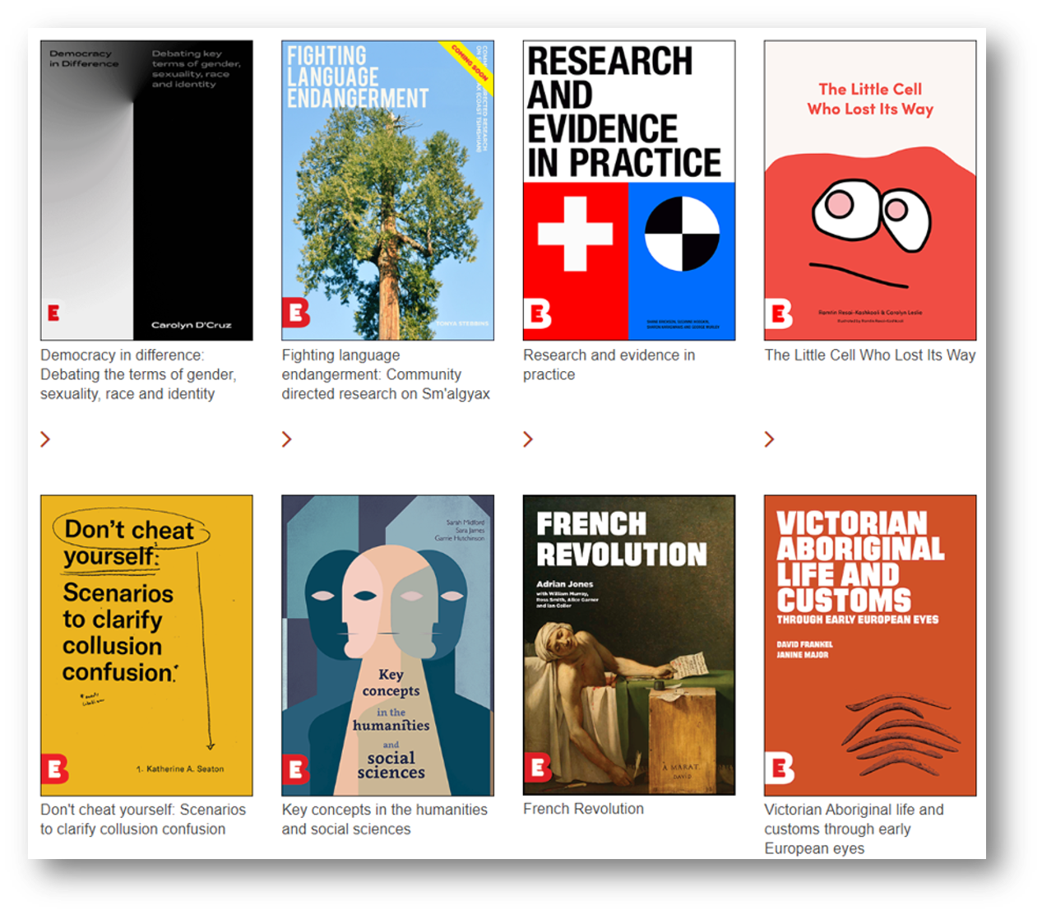
Library as publisher
11 titles in a variety of disciplines so far
Open access
Peer-reviewed
Professionally edited and designed
Visually rich: multimodal learning
Beauty is in the open licensing

Slide 16
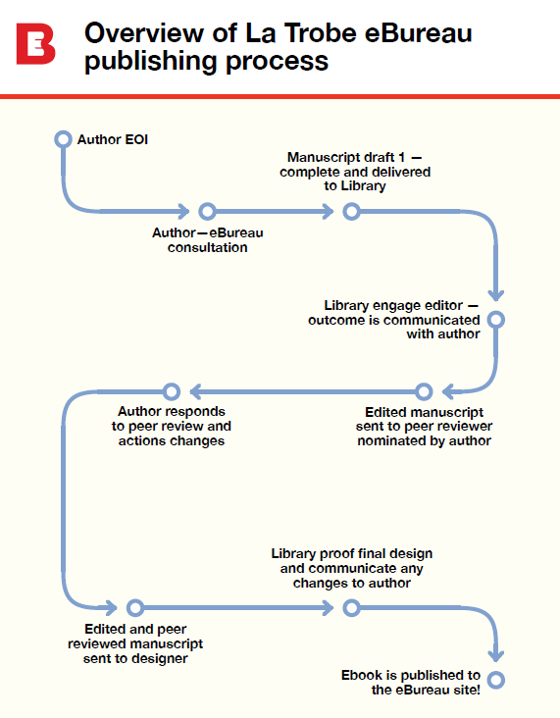
The Library will:
Deliver and direct the publication
Coordinate visual design
Engage external editors
Advise on any necessary structural edits
Facilitate peer review
Collect and collate images, graphics, and multimedia
Comprehensively check copyright for third-party images/material
Digitally publish ebook and mint DOI
Conduct advocacy and promotion campaign
Determine a reasonable publishing timeframe for each publication
SC

Slide 17
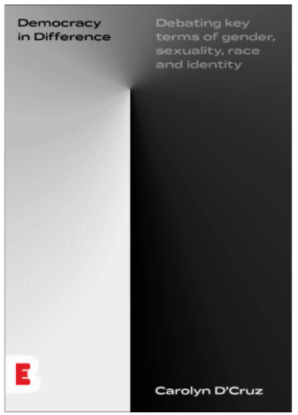
Democracy in Difference by Carolyn D'Cruz (2020)
"Democracy in difference: Debating key terms of gender, sexuality, race and identity focuses on concepts and analytical frames we use when discussing how marginalised identities navigate their place in an assumed common culture."
Beyond text: artworks from La Trobe Art Institute featured
Embedded video links
Music – check out this playlist
Internally linked key concepts
https://library.latrobe.edu.au/ebureau/ebook.html#democracyindifference
SC

Slide 18
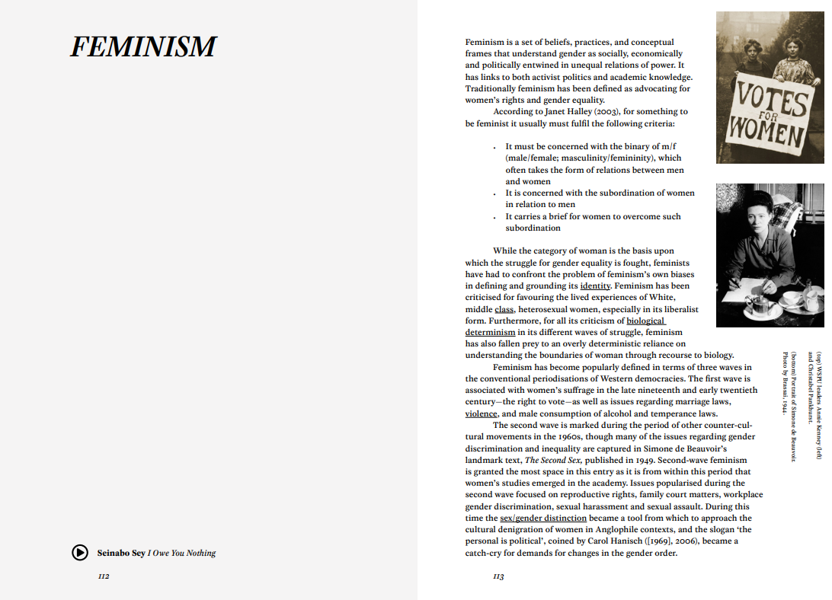
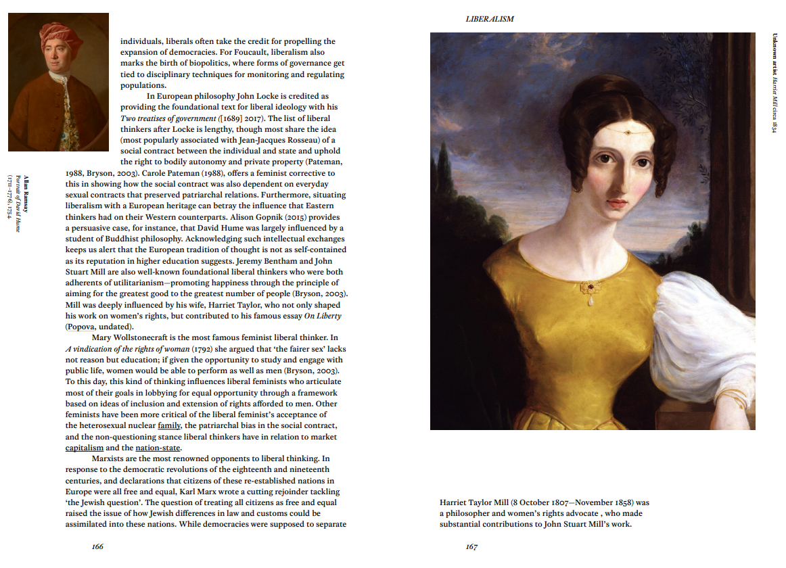
https://library.latrobe.edu.au/ebureau/
SC

Slide 19
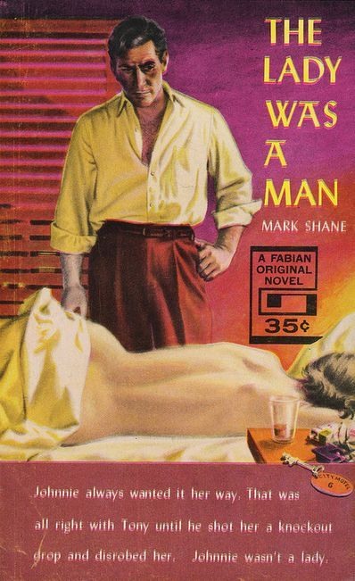
Pulp fiction title (forthcoming, 2020)
Australian pulps 1939–1959: You go high, we go low
by Stuart Kells
Currently in development
Highly visual – pulp covers through history
Open manuscript – seeking ways to use this in CAE learning and teaching
This book explores the pulp publishing scene in Australia from 1939 to 1959. It examines the circumstances that gave rise to this field of ‘low literature’; the major participants in it – publishers, authors and artists – and the different expressions of the pulp genre available to readers, including crime pulps, westerns, sci-fi, romance and ‘weird tales’.
Early preview: https://library.latrobe.edu.au/ebureau/ebook.html#pulps
SC

Slide 20
Open success stories: CAE faculty as publisher
Writing from below (La Trobe)
Platform: Custom
Editors: academics in School of Humanities and Social Sciences
Frequency: twice annually
Topics: gender, sexuality and diversity and intersecting issues that shape their social expression.
Peer review: double-blind (except book reviews, interviews and commissioned works)
Colloquy (Monash)
Platform: Figshare
Editors: postgrad students in the Literary and Cultural Studies Program
Frequency: twice annually
Topics: theoretical humanities, literary and cultural studies, critical theory, continental philosophy, film and television studies, communication and media studies, performance studies, translations, creative writing and book reviews
Peer review: double-blind (except book reviews)
TS
Notes:
Somewhat similar to Colloquy connected to la trobe – The Looking Glass and Screening the Past
Another good environmental humanities example is Landscapes journal by Edith Cowan Uni academics and hosted in their repository

Slide 21
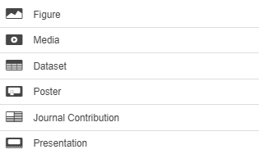
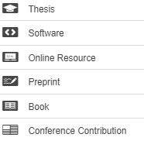
opal.latrobe.com.au
Open publications
Open theses
Open data
Open education res.
Open GLAM
TS

Slide 22
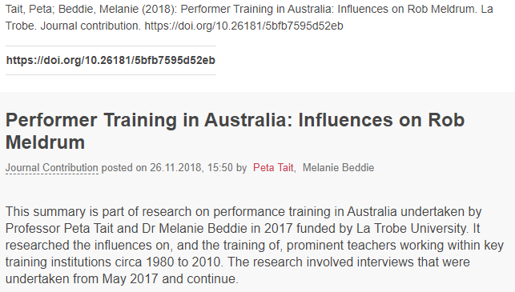
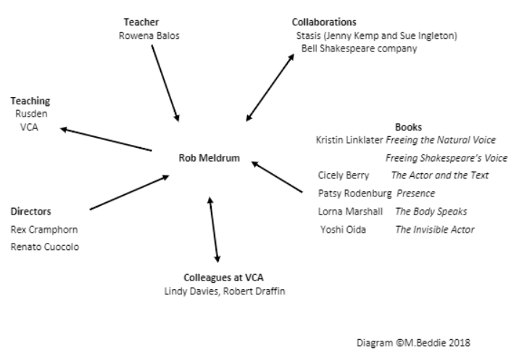
opal.latrobe.com.au
Open publications
Open theses
Open data
Open education res.
Open GLAM
TS
Notes:
AusStage GLAM links to related la trobe uni library circus collections https://www.ausstage.edu.au/pages/learn/about/

Slide 23
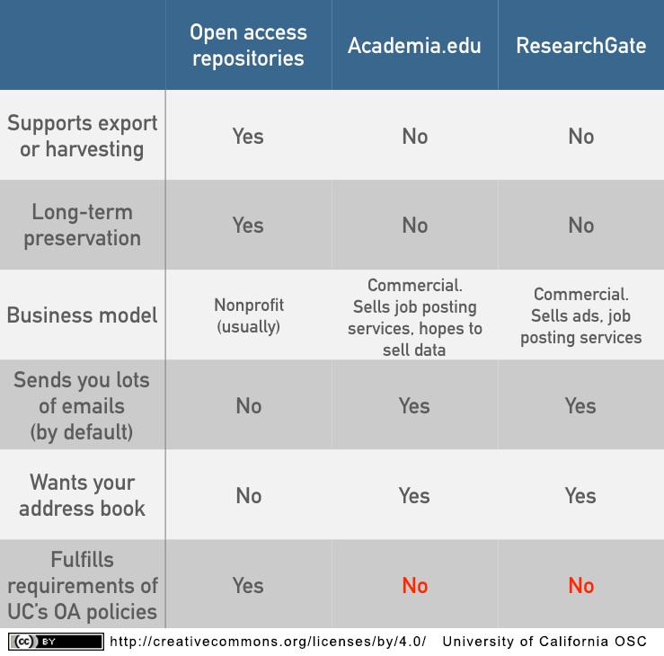
OPAL vs ResearchGate/Academia.edu
Academic social networking sites certainly useful, but institutional repository gives sufficient additional benefits that its use is required by funders.
TS
Notes:
https://osc.universityofcalifornia.edu/2015/12/a-social-networking-site-is-not-an-open-access-repository/
https://kfitz.info/academia-not-edu/

Slide 24
Open actions
Pitch a proposal to La Trobe eBureau
Publish an item on OPAL
Attend OA week
Talk/presentation? Conference/symposia paper? Thesis? Creative output?
Book for teaching at La Trobe
19-24 October
Further details to follow
Includes open GLAM performance with Reid Marginalia
Provide steering input for forthcoming Pulp Fiction title – use in your course
CO

Slide 25
Further reading
Bali, M, Cronin, C, Czerniewicz, L, DeRosa, R, and Jhangiani, R (eds.), Open at the Margins: Critical perspectives on open education, Rebus Community.
Colvard, NB, Watson, CE, and Park, H 2018, "The impact of open educational resources on various student success metrics", International Journal of Teaching and Learning in Higher Education, Vol. 30, No.2, pp. 262-276.
Eversley, S and Hurson, L, 2017, Equality Archive: Open Educational Resources as Feminist Praxis http://equalityarchive.com, Feminist Media Histories, Vol. 3, No.3, pp.154-158.
Fitzpatrick, K, 2015, 'Academia, Not Edu', kfitz.info, blog post, 26 October 2015, viewed 2 September 2020, <https://kfitz.info/academia-not-edu/>.
University of Guelph Library 2020, Commercial Textbooks Present Challenges in a Virtual Environment, viewed 2 September 2020, <https://www.lib.uoguelph.ca/news/commercial-textbooks-present-challenges-virtual-environment>.
Gross, J and Ryan, JC, 2015, Landscapes of research: Perceptions of Open Access (OA) publishing in the arts and humanities, Publications, Vol. 3, No., pp.65-88.
Lundén, T. & Sundén, K. 2015, "Art as academic output : quality assessment and open access publishing of artistic works at the University of Gothenburg", Art Libraries Journal, vol. 40, no. 4, pp. 26-32.
Mallinder, S., and Flint, D., 2010. Sharing higher education learning and teaching resources in art, design and media. Art Libraries Journal, 35(3), pp.35–39.
This presentation is
sharable and reusable
CC BY 4.0
DOI.org/10.26181/5f4f4214d2e4b
CO
Notes:
(and clareifications)

Slide 26
Continue the conversation
Steven Chang
Digital Literacies and Open Education (Library)
Email: s.chang@latrobe.edu.au
Thomas Shafee
Research Data Outputs (Library)
Email: t.shafee@latrobe.edu.au
Clare O’Hanlon
Senior Library Learning Advisor (Library)
Email: c.ohanlon@latrobe.edu.au
CO

Slide 27
Bonus slides…

Slide 28
Open GLAM
Digitised special collections, including:
Australian literature that is linked to climate, writing/past/lives and affect, emotion and society research clusters
La Trobe University history
Exhibitions and/or related material? Community arts archives?

Slide 29
Rounds of drafting
& informal feedback
Can always be shared in a green OA repository at any time
Preprint
Work in progress
Submitted version
Submitted to journal
Peer review
Author corrections
Which?
Can always be shared in a green OA repository after accepted by journal (sometimes after embargo)
Postprint
…version of a publication can I share?
Author-accepted
manuscript (AAM)
Copy-edited
Typeset
Formatted
http://sherpa.ac.uk/romeo/search.php
Published
Can usually only be shared if published by a gold OA or hybrid journal
Version of record
PDF / HTML / XML
DOI from journal
commons.wikimedia.org/wiki/File:Preprint_postprint_published.png, Thomas Shafee, CC BY

