Slide 1
Open Educational Resources and Scholarship in Law: State of Play
Steven Chang, La Trobe University
Coordinator, Digital Literacies and Open Education (Library)
Thomas Shafee, La Trobe University
Officer, Research Data Outputs (Library)
Australian Law Librarians’ Association
PD Webinar: Thursday 30th July 2020
doi.org/10.26181/5f210c6e1ff83
This presentation is sharable and reusable: CC BY 4.0

Slide 2
Background
Open scholarship
Open education resources
Print → electronic revolution
COVID-19 impact and opportunities

Slide 3
Overview: what is open scholarship?
Principles
Applications
Wherever possible:
Give freedom for others to use, share and adapt resources
Maximise transparency and accountability
Clearly license rights and requirements
Open Education Resources
Knowledge equity
Cost reductions
Academic publications
Individual reach and impact
Maximise efficiency of scholarly corpus
Data & code
Reproducibility
Meta-analysis & integration
Also theses, performance assessment, strategy, decision making, accounting
Findable
Interoperable
Accessible
Reusable
Wilkinson, Mark D., et al. "The FAIR Guiding Principles for scientific data management and stewardship." Scientific data 3.1 (2016): 1-9.
TS
Notes:
But principles can apply as wide as transparent criteria for performance assessment (e.g. DORA), strategy and decision making, Open-book accounting, etc.

Slide 4
Open access in legal studies: Uptake
Few open Australian law textbooks:
Mainly specialist subjects
No open textbooks on Priestley 11
~260 OA law journals in the Directory of Open Access Journals (DOAJ) though likely an undercount, including:
Law in Context (published at La Trobe)
Stanford Technology Law Review
Harvard Human Rights Journal
Repositories include:
Analysis & Policy Observatory (APO)
Social Sciences Research Network (SSRN)
Many databases paywalled:
HeinOnline Academic Core (Australia/New Zealand)
OpenAustralia only has commonwealth Hansard (not state)
Key declaration: Durham Statement on Open Access to Legal Scholarship
“…it will benefit legal education and improve the dissemination of legal scholarly information if law schools commit to making the legal scholarship they publish available in stable, open, digital formats in place of print.”
Kinder, Petal. "Free, Open, and Re-Usable Access to Legal Information-The Australian Experience." Int'l J. Legal Info. 45 (2017): 45. doi.org/10.1017/jli.2017.12
Hajjem, Chawki, Stevan Harnad, and Yves Gingras. "Ten-year cross-disciplinary comparison of the growth of open access and how it increases research citation impact." arXiv preprint cs/0606079 (2006).
TS

Slide 5
McKiernan, Erin C., et al. "Point of view: How open science helps researchers succeed." Elife 5 (2016): e16800. doi.org/10.7554/eLife.16800
10x
Open access in legal studies:
Citation advantage
3x
OA:non-OA citation ratio
1x
Biology
Ecology
Business
Health
Medicine
Education
Economics
Philosophy
Psychology
Agriculture
Engineering
Mathematics
Management
Communications
Political science
Computer Science
Law & Legal studies
Sociology/soc. science
Physics/astronomy
TS
Notes:
Citation metrics are an easy and well-measured example of the effect of open access content. For journal publications in law and legal studies, there is a consistent and measurable increase in impact within the academic community.
This may also reflect broader reach, engagement and impact outside the ivory tower.

Slide 6
The crisis: equity in education
When textbook costs are approaching, Ms Dove eats canned tuna to save money.
"I budget by buying non perishables and cooking really, really cheap food. If you're living out of home you already have bills, rent and other living costs," the 21-year-old said.
"I'm living from paycheck to paycheck.“
Why are textbooks so expensive in Australia?
SC

Slide 7
Overview: what is an OER?
“OER are teaching, learning, and research resources that reside in the public domain or have been released under an intellectual property license that permits their free use and re-purposing by others. Open educational resources include full courses, course materials, modules, textbooks, streaming videos, tests, software, and any other tools, materials, or techniques used to support access to knowledge.”
The William and Flora Hewlett Foundation
Read-only culture read-write culture.
SC
Notes:
What can I do with this thing?
An OER says: many things! Go for it – as long as your use adheres to the activities permitted by the license.
A traditional commercial learning resource says: here is a long list of things you cannot do with this resource. A whole world of possibilities is ruled out a priori, by the terms of restrictive commercial licenses.
OER comes in many forms…

Slide 8
Benefits of OER
Reduce costs
Cost of education is a key barrier to equitable learning – OER levels the playing field
Innovation
Opens new ways of learning and teaching through co-creation, participatory student engagement rather than passive consumption
Save time
Don’t reinvent the wheel! Adapt, customise, and localise existing content to suit your course
Lifelong learning
Students can freely use resources after graduation in their workplaces and communities
Efficiency
Rapid circulation & currency at scale. Keep pace with the changing world.
SC
Notes:
Levelling the playing field is profound. Access to education means access to knowledge, which means access to agency, access to means of change to improve society from different perspective.
But it's not just all about costs. It's about new ways of learning altogether.
Avoid reinventing the wheel. Millions of educators. Adapt existing open material, then localise it.
Lifelong learning - we don't stop learning just because we've graduated. Revisiting past lessons.
Highly adaptable in a changing world. When mega-events like COVID and GFC drop, you can instantly update content as a user/reader.
Read-write relationship. Not read-only.

Slide 9
SC
Notes:
It's not just about airy-fairy utopianism. It's borne out in the evidence and data.
OER improves learning outcomes. Not just generally, but PARTICULARLY for underserved populations and precarious students from lower socio-economic backgrounds.
This is important because of misconceptions that free = low quality. There is nothing about commercially produced resources that guarantees quality.
Reference to this paper at the end of the presentation.

Slide 10
Beyond open access
Common mistake is to narrowly focus on “open access”
This means little to most stakeholders
Open access is a means, not an end
What is the “so what?” of open scholarship?
Use the “Five Rs” (OER) or F.A.I.R. (research) principles as a bridge between open access and the “so what?”
Img: https://www.flickr.com/photos/ellenmetter/37631415622 Ellen September, CC BY
SC
Notes:
A common mistake librarians make is to narrowly focus on “open access” only.
Firstly, open access means little to anyone except people who are already converts.
But…open access as means to what? What is the “so what”?
The answer you give here is the key to persuading stakeholders, but also thinking about why we're doing it, how do we get value out of it.
One bridge between open access and So What is FAIR/the Five Rs
e.g. Download an American open textbook chapter, adapt and edit it to contextualise it from an Australian perspective, and then remix it with your own authored chapters into comparative law open textbook of your own. Share with your students and Americans!

Slide 11
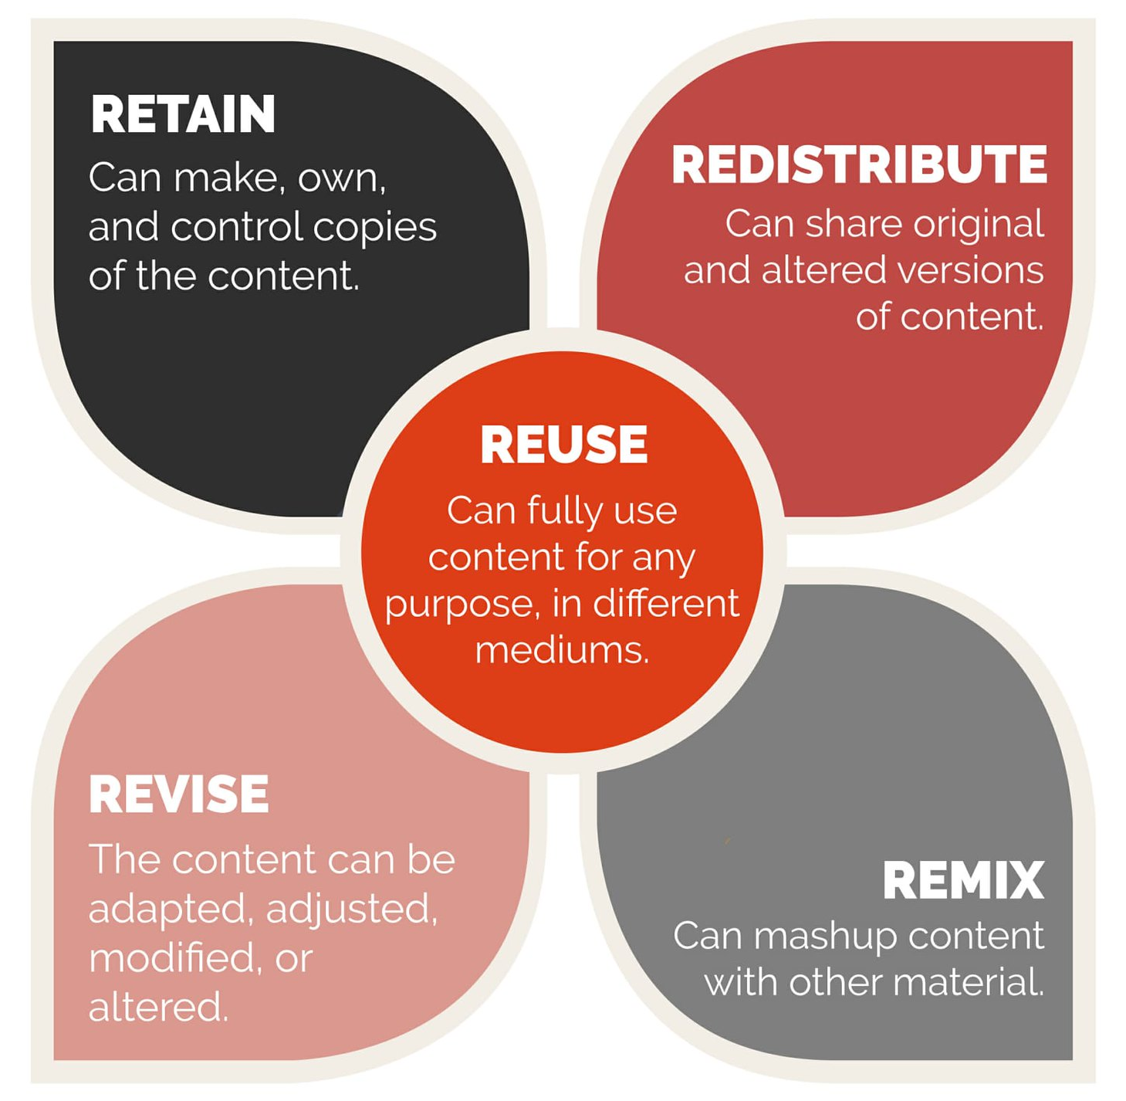
Beyond open access
Findable
Interoperable
Accessible
Reusable
Img: https://www.flickr.com/photos/ellenmetter/37631415622 Ellen September, CC BY
SC
Notes:
A common mistake librarians make is to narrowly focus on “open access” only.
Firstly, open access means little to anyone except people who are already converts.
But…open access as means to what? What is the “so what”?
The answer you give here is the key to persuading stakeholders, but also thinking about why we're doing it, how do we get value out of it.
One bridge between open access and So What is FAIR/the Five Rs
e.g. Download an American open textbook chapter, adapt and edit it to contextualise it from an Australian perspective, and then remix it with your own authored chapters into comparative law open textbook of your own. Share with your students and Americans!

Slide 12
Background: Print to Electronic revolution
Print
Electronic
Free to read
Artificial scarcity
Open
Restricted usage
Strict DRM
FAIR/Five Rs
Knowledge equity
Traditional limitations
Paywalled
Access isn’t enough
SC
Notes:
Last 30 years we’ve been through a slow, tentative, and incomplete Print to Electronic revolution
Future of the book – what happened to that utopian dream?
DRM happened
Artificial scarcity happened
More things are increasingly free to read – ABC comparison. You can’t do anything else with it than passively consume.
We should aim high and aspire to “true open access” and the five Rs – where resources become dynamic sites of engagement, not just something you read.
But there is a tension between idealism and pragmatism.
Our pragmatist position at LTU: Zero Textbook Costs for students. Regardless of whether that involves library subscriptions to DRM-protected resources, DRM-free resources, or “true open access” resources. In reality it will be some combination of these.

Slide 13
Background: COVID-19 crisis
OERs
Broader open scholarship
Social distancing – print access challenges
Quarantining (of print books!)
Unemployment crisis
Textbook affordability
Rapid move to online teaching
Golden opportunity for advancing open textbooks
Time to rethink the promise of digital education altogether
Almost all publishers release COVID research ‘openly’
Many not true OA, just free to read
arbitrary amount of time as decided by publisher
‘COVID-relevance’ decided by publisher
Highlights relevance of open data
E.g. linking datasets on infection rates, legal codes, viral genomes
SC TS
Notes:
COVID-19 is a chance to go back to the question of what was and is the original promise of digital education
Optimism in the 90s about the promise of instant, digital, affordable access to education as well as new ways of engaging students where they have an interactive/co-creative relationship with learning resources rather than being passive recipients
In many ways we've fallen short of the promise - there are still barriers to equity, to access, to engaging students
The new COVID world is a double edged sword
Sharpens existing inequities and barriers
e.g. social distancing and the Library, and student unemployment crisis
conversely, sudden transition to online forces us to rethink digital learning and do it better
A lot of the unsolved dilemmas come down to licensing. We can solve this with OEP.

Slide 14
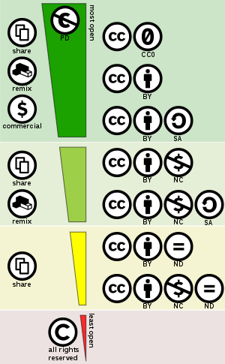
Background: Creative Commons
Creative Commons licensing is the engine of OER
Clear usage rights:
Share : copy and redistribute the material in any medium or format
Adapt : remix, transform, and build upon the material for any purpose
Clear requirements:
Attribute : You must give appropriate credit, provide a link to the license, and indicate if changes were made. You may do so in any reasonable manner, but not in any way that suggests the licensor endorses you or your use.
Enables use at scale without seeking case-by-case permissions
https://creativecommons.org/licenses/by/4.0/
Img: commons.wikimedia.org/wiki/File:Creative_commons_license_spectrum.svg, Shaddim, CC BY
TS
Notes:
CC licensing is the tool

Slide 15
Stakeholders
Academics
Students
Libraries and librarians

Slide 16
Stakeholders: Academics
Contradiction 1: academics have agency to change the situation, yet they are entangled in a vicious cycle
Course structures “locked” into commercial textbook structures
Culture of prestige as currency, established perceptions about quality
Contradiction 2: OER can save academics time, but they feel they have no time to make shift to OER
Hierarchical and power differentials
Early career/casual academics may have the desire, but not the power to make change
Low awareness of Creative Commons and copyright – support is needed
Common misconceptions associating free access with “low quality”
SC

Slide 17
Stakeholders: Students
Equity and access to education
Zero Textbook Costs for students
New ways of engaging with educational resources
Active agents engaged with text, not passive consumer
Student as co-creators
Digital literacy and capability development
SC

Slide 18
Stakeholders: Libraries and librarians
Advocates & educators
Libraries as (open) publisher – e.g. La Trobe eBureau, publishing OER in Figshare, etc
Advancing policy reform, e.g. UWA open-friendly IP policy
Copyright experts
Strategically positioning ourselves as agents of change, equity, and innovation
Free up library collection budgets!
SC

Slide 19
Practice
Success stories
Barriers & solutions

Slide 20
Open success stories: Library as publisher
OER usage case study:
David Walker, La Trobe (Business & Economics)
Frustration with pricey, soon outdated commercial textbooks
Converted course to use open textbooks published by CORE Econ Project
SC
Notes:
Currency and
David Walker example was possible because there are business/economics texts out there to adopt
This is more difficult for law where there are fewer open texts available
Therefore, academics and librarians creating new texts is paramount

Slide 21
Library as publisher
11 titles in a variety of disciplines so far
Open access
Peer-reviewed
Professionally edited and designed
Visually rich: multimodal learning
Beauty is in the licensing – but it’s tricky!

Slide 22
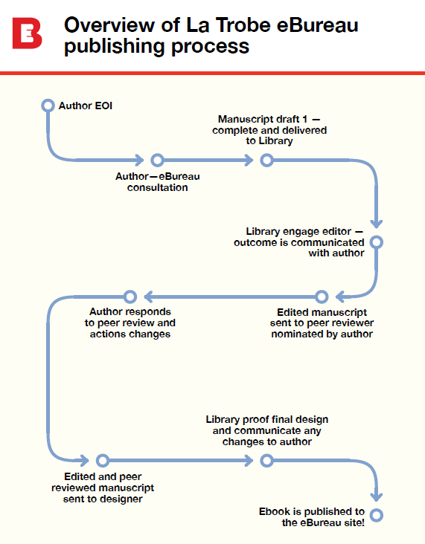
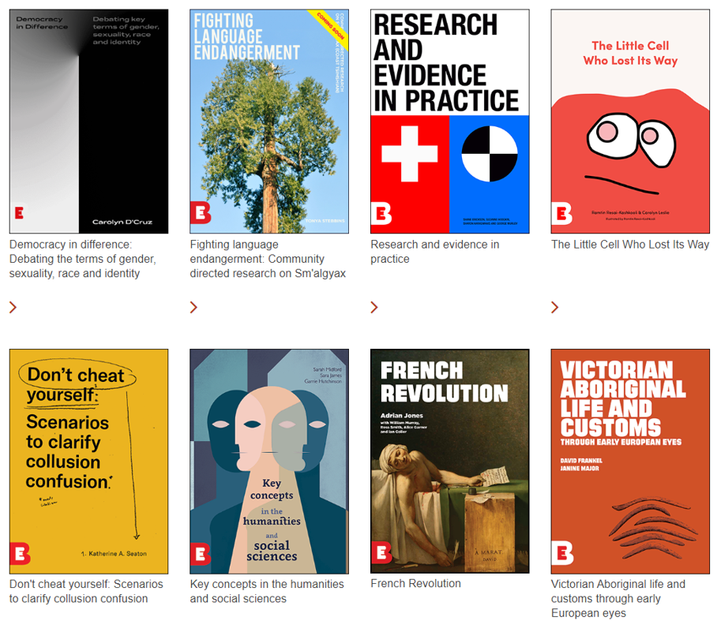
SC

Slide 23
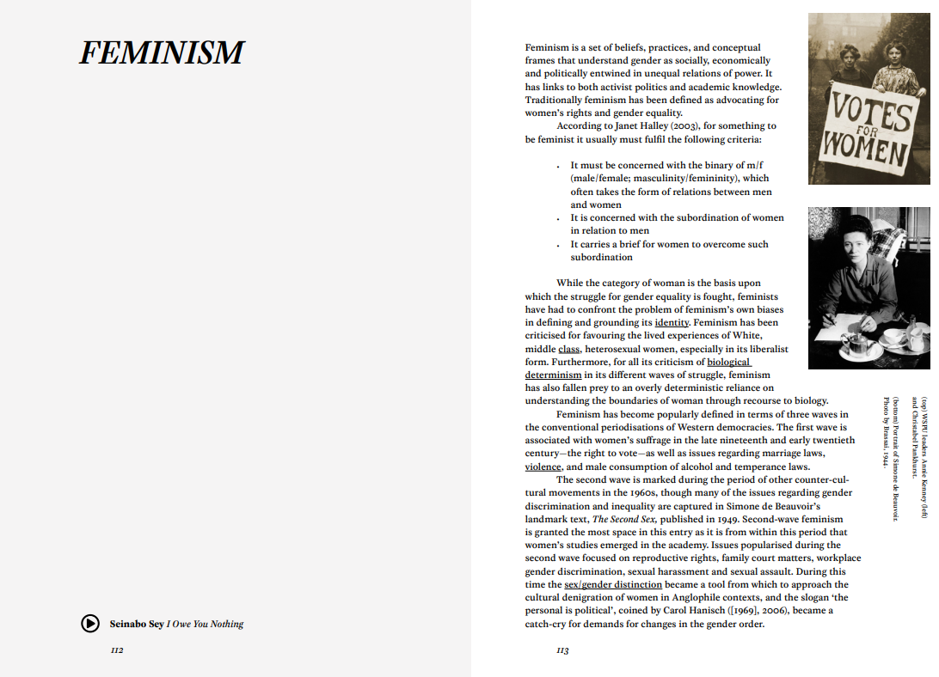
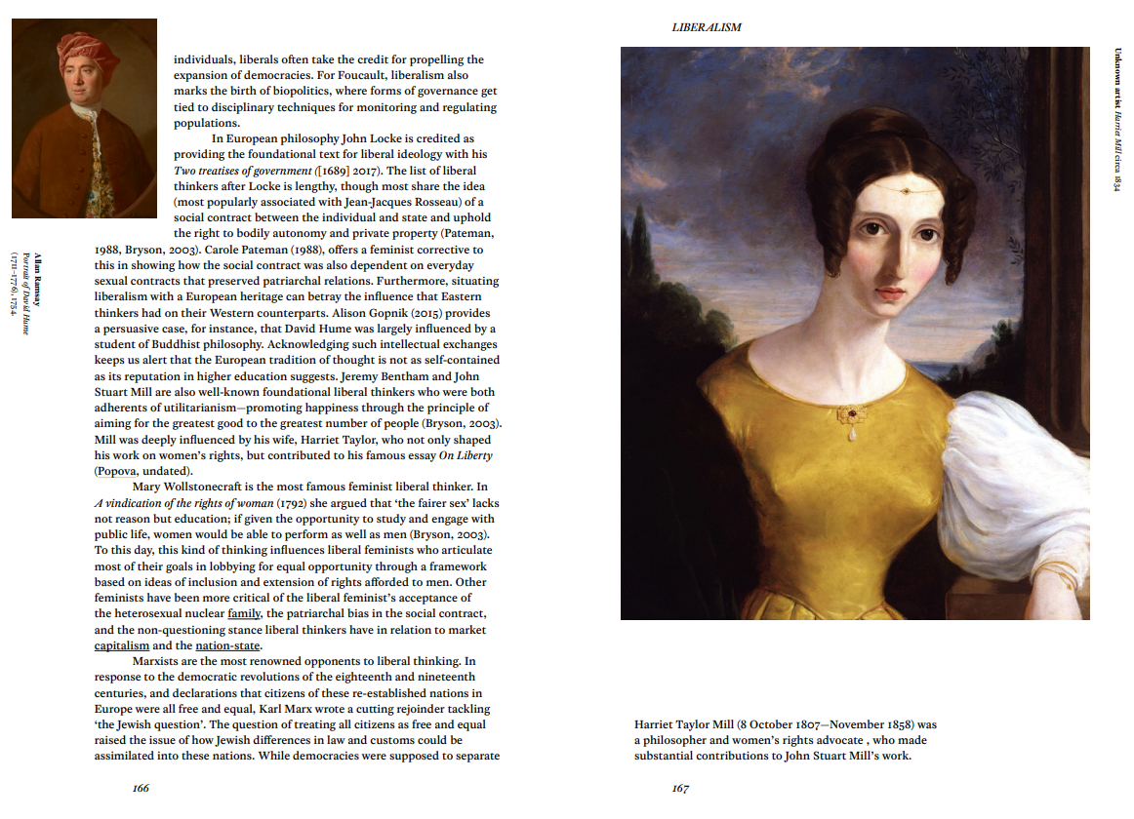
https://library.latrobe.edu.au/ebureau/
SC

Slide 24
Open success stories: Law faculty as publisher
Law in the Time of COVID-19 – by the Columbia Law School
COVID-19 and the law of Australia – written by barristers of the Victorian Bar
WikiJuris books
Harvard Law School eLangdell Bookstore
OpenStax: Business Law Essentials
Law in Context (La Trobe)
Published since 1983
Flipped to Open Access 2019
Published using Open Journal Systems
Casanovas, Pompeu, Jianfu Chen, and David Wishart. "Law in Context for the Digital Age." Law in Context. A Socio-legal Journal 36.1 (2019): 3-11.
SC TS
Notes:
Motivations – why?

Slide 25
Advancing open scholarship in law: barriers
OERs
Broader open scholarship
Conservative culture in law – attachment to prestige and canon texts
Lack of Australian titles in the open textbooks landscape
Difficult to adapt U.S. resources (say, compared to physics or mathematics!)
Incentives: what’s in it for [given stakeholder]?
Mandates from funders, journals and institutions lacking
- e.g. since 2018, ARC mandates all research output to be released OA within 12 months
Stakeholders outside of universities
- e.g. practicing lawyers
Severin, Anna, et al. "Discipline-specific open access publishing practices and barriers to change: an evidence-based review." F1000Research 7 (2018). https://doi.org/10.12688/f1000research.17328.2
SC TS
Notes:
Taking a step back: the relative barriers in different fields affect culture (e.g. in maths, all high prestige publishing is done openly).

Slide 26
Advancing open scholarship in law: solutions
Advocate strategically. Where are the openings?
Frame benefits clearly to stakeholders
Focus on gains for learning and students - not just the resource
Advocating for open access “by stealth”. Frame it in terms of the “so what?”
Diversity, inclusion, and equity – see RMIT’s Open Educational Practices Framework
Open avenues for creating OER
What’s in it for them?
Carefully select timing, circumstances, and stakeholders
Target new courses, units under redesign
Engage academics who are “open to open”
Library as publisher
Library as facilitator for platforms like PressBooks
OER grants programs
SC
Notes:
We do ourselves no favours if we just run in with all guns firing like a bull in a China shop. Pick the right timing, circumstances, and pitch carefully to each stakeholder. Target new courses, units under review, and academics you sense are “open to open” i.e. open-minded and willing.

Slide 27
Where to find OER
Textbooks:
Open Textbook Library
OpenStax
BCCampus open textbooks
Federated search: search everything open!
MERLOT
OER Commons
Mason OER MetaFinder
Images:
Creative Commons Search
Pixabay
Open datasets:
Research Data Australia
Figshare
SC

Slide 28
Some take home quotes
“Law journal publishing is one of the easiest cases for open access publishing. Law scholarship relies on few commercial publishers. The majority of law journals depend on unpaid students to undertake the selection and copy editing of articles. Nobody who participates in any way in the law journal article research, writing, selection, editing and publication process does so because of copyright incentives.”
Litman, Jessica
The Economics of Open Access Law Publishing
“…significant progress has been made, however, there remains much more information (that has been gathered at taxpayers' expense) that could be made freely available without restriction as to its use.”
Kinder, Petal
Free, Open, and Re-Usable Access to Legal Information - The Australian Experience
“… publishers now use powerful legal tools to control who has access to the text of the law, how much they must pay, and under what terms.”
“Meaningful access to the law is a fundamental prerequisite for due process, and ultimately the rule of law, yet the problem of private control is longstanding and growing worse in the advent of electronic publishing and publisher consolidation.”
Street, Leslie; Hansen, David
Who Owns the Law: Why We Must Restore Public Ownership of Legal Publishing
TS
Notes:
Since Steven and I are speaking as outsiders to this field: Some quotes from people with legal scholarship backgrounds

Slide 29
Further reading
General OA and open research
Who Owns the Law: Why We Must Restore Public Ownership of Legal Publishing
Revisiting the Open Access Citation Advantage for Legal Scholarship
The Movement for Open Access on Law
The Economics of Open Access Law Publishing
OER and open textbooks
Free law textbooks raise questions about OER
RMIT Open Educational Practices Framework
How professors help rip off students (written by law professor Tim Wu)
Colvard, N. B., Watson, C. E., & Park, H. (2018). The impact of open educational resources on various student success metrics. International Journal of Teaching and Learning in Higher Education, 30(2), 262-276.
McFarlin, Timothy, Using Open-Source, Collaborative Online Reading to Teach Property (October 8, 2019). 64 St. Louis University Law Journal, 355 (2020), Available at SSRN: https://ssrn.com/abstract=3558169
DAVIS, L., & NEARY, M. A. (2020). Leveraging Open Educational Resources & Affordable Course Materials In Legal Education: Academic law librarians drive change that reduces costs and benefits law students. AALL Spectrum, 24(5), 40–43.
This presentation is
sharable and reusable
CC BY 4.0
doi.org/10.26181/5f210c6e1ff83

Slide 30
Stay in touch
Steven Chang, La Trobe University
Coordinator, Digital Literacies and Open Education (Library)
Email: s.chang@latrobe.edu.au
Twitter: @StevenPChang
LinkedIn: https://www.linkedin.com/in/stevenchang1/
Thomas Shafee, La Trobe University
Officer, Research Data Outputs (Library)
Email: t.shafee@latrobe.edu.au
LinkedIn: https://www.linkedin.com/in/t-shafee/

Slide 31
Bonus slides…

Slide 32
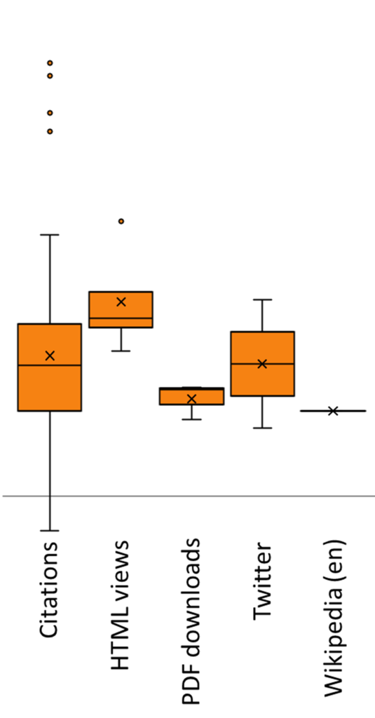
Benefits to you
10x
3x
Why?
OA:non-OA citation ratio
OA publications
+30-800% citations
OA associated data +20-60% citations
…should I share publications openly?
1x
commons.wikimedia.org/wiki/File:Open_access_citation_advantage.png, Thomas Shafee, CC BY
Notes:
For Australian research: normal research = 11 cites, but OA = 15 cites

Slide 33
Rounds of drafting
& informal feedback
Can always be shared in a green OA repository at any time
Preprint
Work in progress
Submitted version
Submitted to journal
Peer review
Author corrections
Which?
Can always be shared in a green OA repository after accepted by journal (sometimes after embargo)
Postprint
…version of a publication can I share?
Author-accepted
manuscript (AAM)
Copy-edited
Typeset
Formatted
http://sherpa.ac.uk/romeo/search.php
Published
Can usually only be shared if published by a gold OA or hybrid journal
Version of record
PDF / HTML / XML
DOI from journal
commons.wikimedia.org/wiki/File:Preprint_postprint_published.png, Thomas Shafee, CC BY

Slide 34
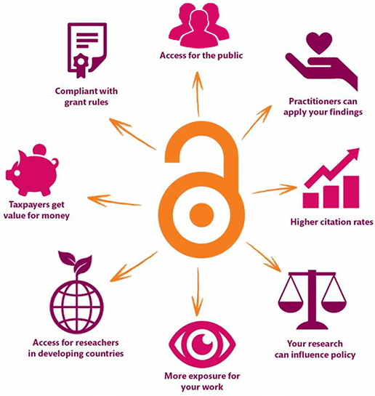
Benefits: open research outputs
Img: Danny Kingsley & Sarah Brown, CC BY

