Slide 1
Wikipedia-integrated academic publishing
@WikiJMed
@WikiJSci
@WikiJHum
Maximising reach and impact
May 2020, CC BY 4.0

Slide 2
Combining reach and rigour
compatible interfaces between two worlds

Slide 3
Who reads Wikipedia?
Thesis
1-10
Median Wikipedia page
10,000 pa
Median Journal Paper
800
Readership includes: Researchers
Students
Patients
Journalists
Clinicians
Lawmakers
Top 5% Journal Paper
3,000
Top 5% Wikipedia page
1,000,000 pa
Shafee T (2017) Wikipedia-integrated publishing: a comparison of successful models. Health Inform. 26(2)
Notes:
Re-emphisise that patients are making health decisions based on what they read online

Slide 4
Who reads Wikipedia?
Covid-19
400,000 per day
Thesis
1-10
Median Wikipedia page
10,000 pa
Median Journal Paper
800
Readership includes: Researchers
Students
Patients
Journalists
Clinicians
Lawmakers
Top 5% Journal Paper
3,000
Top 5% Wikipedia page
1,000,000 pa

Slide 5
Quality control
Creation
Articles for Creation (Drafts not yet added to encyclopedia)
New page patrol (Articles recently added)
>2000 new articles submitted per day (70-80% are deleted)
Modification
Articles for Deletion
Speedy deletion (1 day)
Proposed deletion (1-4 weeks)
50 per day
Deletion
Notes:
Overall Birth-and-Death model for articles, but most work done in modification
>300 active editors in each stage
600 new articles per day
500 deletions per day

Slide 6
Quality control
Bots
(<1 minute)
Human
(<1 hour)
Human
(hours - days)
Quality rating
Machine-learning:
Watching new edits stream
Apprx. 100 at any time
e.g. sentences lacking references
Checking for more subtle errors
Bayesian neural network
Turnitin: Copyright violation
Creation
Modification
Deletion
Notes:
Overall Birth-and-Death model for articles, but most work done in modification

Slide 7
Quality control
Creation
Editorial review
5-10 reviewers
1 reviewer
Internal assessment
Modification
Wikipedia’s Plant Biology pages
Quality comparable to Encyclopædia Britannica back in 2005
Accuracy varies by topic, but broad trends:
Inconsistent coverage
Missing / out of date information
Missing illustration
Difficult readability
Deletion
External assessment
Nature 2005 438:900 | S Fox, M Duggan Pew internet 2013 | T Shafee et al. (2017) JECH. 71(10)
Notes:
Overall Birth-and-Death model for articles, but most work done in modification

Slide 8
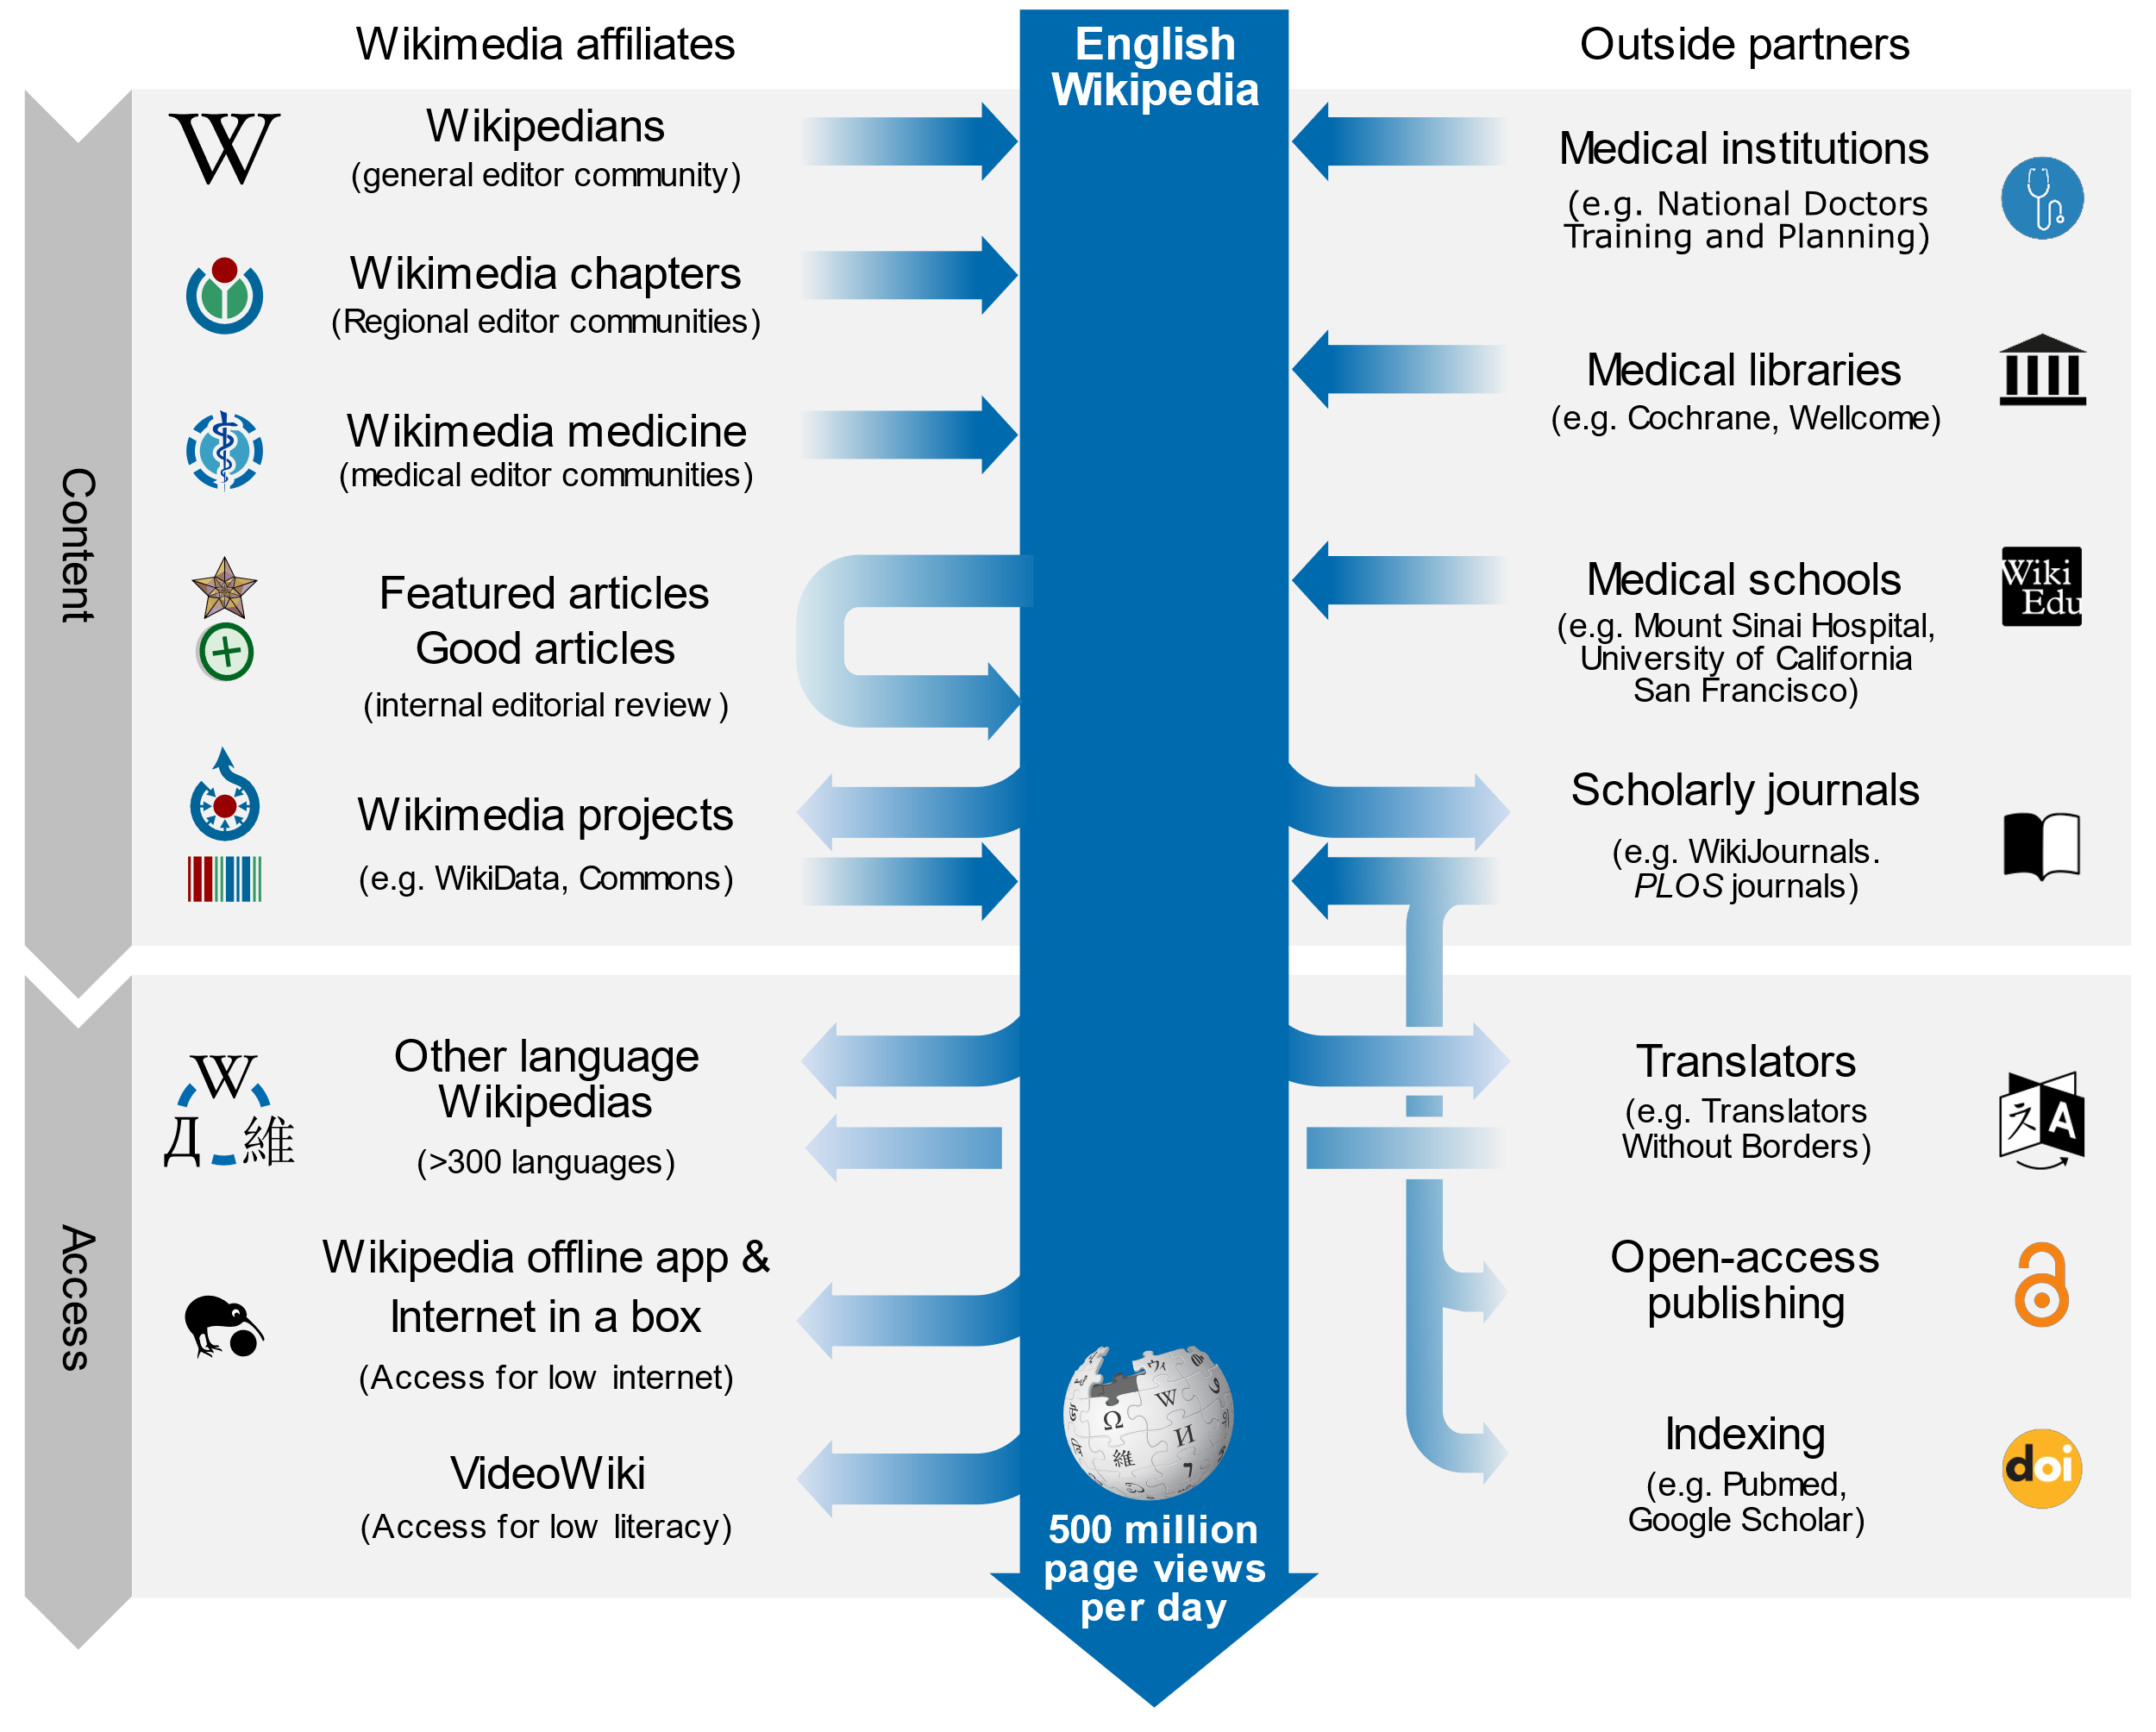
Interactions with the knowledge ecosystem

Slide 9
Implementation models
Practical and proven methods

Slide 10
Development of concepts
2008 – RNA Biology starts requiring authors to update Wikipedia
2014 – Open Med puts Wikipedia page through peer review
2014 – WikiJMed publishes first issue
2018 – WikiJSci & WikiJHum publishes first issue
2012 – PLOS Comp Biol starts publishing ‘topic page’ review format
2013 – Gene starts Gene Wiki Reviews
2018 – PLOS Genetics also starts publishing ‘topic page’ format

Slide 11
Bridging the academic divide
Compatible with any OA journal
Simplest workflow
Well-suited to topics that are missing/start/stub on Wikipedia
Content published into both Wikipedia and academic corpus
Stable, citable, peer-reviewed journal version
Living version with extreme impact of Wikipedia
Example journals
PLOS Genetics
PLOS CompBiol
PLOS ONE
Wiki.J.Med
Wiki.J.Sci
Wiki.J.Hum
Open Medicine
Gene
RNA Biology
Journal first
Restricted by Wikipedia’s CC-BY-SA license
May be only option for highly-developed pages (full replacement typically more difficult Class B and above)
Wikipedia first
Compatible with closed journal
Two versions can be tailored to different audiences
Increased work for authors and reviewers
Parallel
Shafee, T. (2017). Wikipedia-integrated publishing: a comparison of successful models. Health Inform., 26(2).

Slide 12
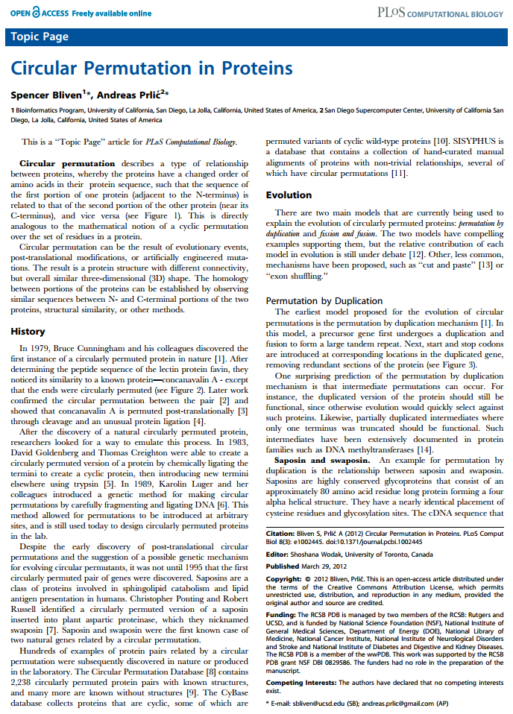
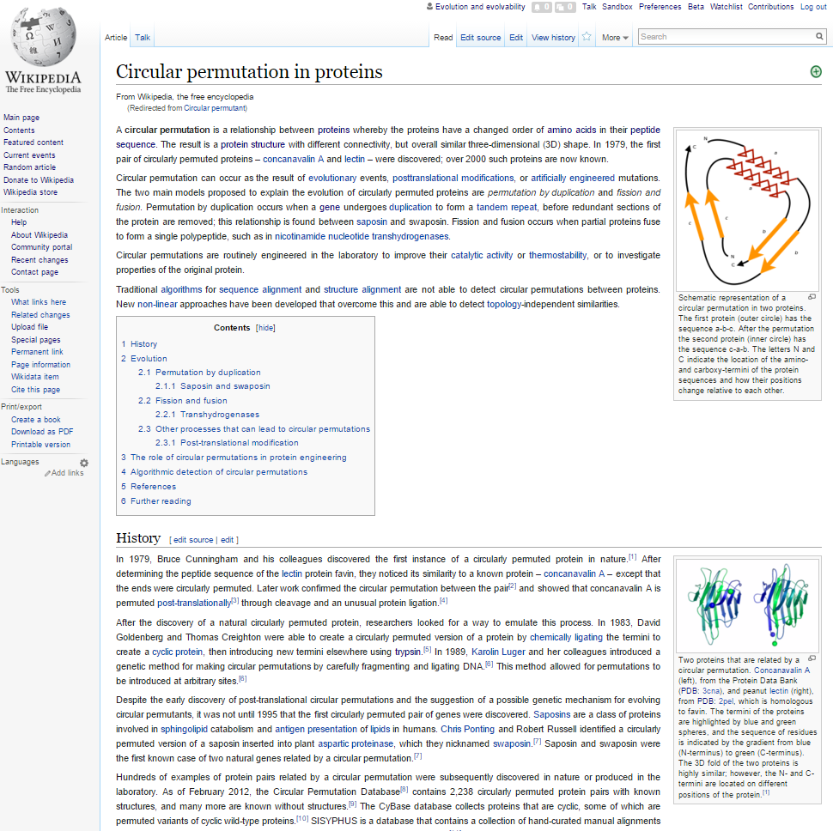
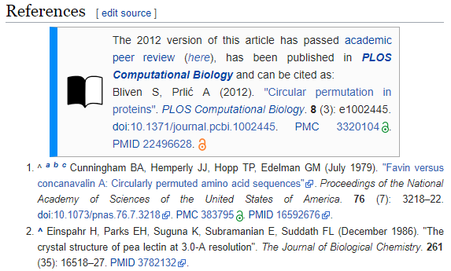
Academic and Wikipedic versions

Slide 13
WikiJournals

Slide 14
Example case studies in WikiJournals
Update using Wikipedia page contents as starting point
In all quality ratings cases, individual article sections can typically be rewritten from scratch
Update by re-writing from scratch

Slide 15
Example case studies in WikiJournals
Full review articles
Article sections
Stand-alones
Existing high-quality Wikipedia article updated and submitted
Peripatric speciation
Rosetta stone
Wikipedia article previously existing but flawed/outdated
Lysine
Wikipedia article previously completely absent/stub
Anthracyclines
Wikipedia article section that warranted own page
Gene structure
Wikipedia article previously lacked images
Cell disassembly during apoptosis
Case study
Acute gastrointestinal bleeding from a chronic cause: a teaching case report
Teaching method
A card game for Bell's theorem and its loopholes
Systematic review
Mealtime difficulty in older people with dementia
Image gallery
Medical gallery of Blausen Medical
Partner articles
More technical partner
Dioxins and dioxin-like compounds

Slide 16
A WikiJournal’s publishing flow
Publication
PDF
Citable
Stable
Indexed
Version of record
Preprint
server
Public
peer review
HTML
doi
Highly accessed
Broad readership
Editable and updatable
Wikipedia-integration
WikiJSci Editorial Board. (2018). The aims and scope of WikiJournal of Science. WikiJSci 1(1)

Slide 17
A WikiJournal’s publishing flow
Preprint server
Publication
PDF
Citable
Stable
Indexed
Version of record
Public
peer review
HTML
doi
Highly accessed
Broad readership
Editable and updatable
Wikipedia as preprint
Wikipedia-integration
WikiJSci Editorial Board. (2018). The aims and scope of WikiJournal of Science. WikiJSci 1(1)

Slide 18
A WikiJournal’s publishing flow
Preprint server
Publication
PDF
Citable
Stable
Indexed
Version of record
Public
peer review
HTML
doi
Highly accessed
Broad readership
Editable and updatable
Versioning
Wikipedia as preprint
Wikipedia-integration
WikiJSci Editorial Board. (2018). The aims and scope of WikiJournal of Science. WikiJSci 1(1)

Slide 19
Sooooo… who pays?
Reader subscription / author (e.g. Gene, RNA Biol)
Typically charge subscription fees
Article processing fee of $3300 and $2000 respectively
Journal fee waiver (e.g. PLOS)
For Topic Page review articles, PLOS waives its usual $2250 processing fee
Charitable foundation (e.g. Wiki.J.Med.)
Web hosting cost is covered by the Wikimedia Foundation
Editors donate volunteer labour so no fees of any kind

Slide 20
What does the future hold?
Maximising potential value

Slide 21
Wikimedia journal hosting platform
Wikipedia Sister project
In whole
WikiJournals
PLOS Genetics
Host
Format
Example
One-off
examples in negotiation
In part
Features
Free interface for formatting articles ready for Wikipedia
Expert editors who give free advice and assistance
Specialist tools for facilitating the process

Slide 22
Wikimedia journal hosting platform
Site identity and branding
journals.wikimedia.org / wikijournals.org / journals.wiki / j.wiki
Specialised sidebar items and logos
CC BY default license
Automation of repetitive tasks
Assigning DOIs
Copying accepted articles into latest volume & issue
Formatting PDFs
Specialised extensions
Annotating history to mark version as published
Automated email reminders to reviewers
Wikidata integration to track peer reviews submitted to talkpages
Features

Slide 23
Contact
Email Thomas.Shafee@gmail.com
Google Scholar Thomas Shafee
ResearchGate Thomas Shafee
LinkedIn Thomas Shafee
Journals
WikiJournal of Medicine (WikiJMed.org)
WikiJournal of Science (WikiJSci.org)
PLOS (TopicPagesWiki.plos.org)
Wikipedia
My userpage Search “User:tshafee”
WikiProject Medicine Search “WP:MED”
This presentation
bit.ly/WikiJournal2020b
Shafee, T; Mietchen, D; Su, A. (2017). “Academics can help shape Wikipedia”. Science. 357 (6351): 557–558.
Shafee, T; Masukume, G; Kipersztok, L; Das, D; Häggström, M; Heilman, J. (2017). “The evolution of Wikipedia’s medical content: past, present and future”. JECH. 71(10).
Shafee, T (2017) “Wikipedia-integrated publishing: A comparison of successful models”. Health Inform. 27(2)
WikiJSci Editorial Board (2018). “The aims and scope of WikiJournal of Science”. WikiJournal of Science 1(1):1

Slide 24
[end]

Slide 25
Possible journal partnership system
One-off partnering with subject-specialist journals
Specialist journal: Invite authors, identify peer reviewers
WikiJournal: Advises on wikipedia policy compliance, readability and formatting
Resulting article co-published in specialist journal & WikiJournal
Then copied into Wikipedia per ‘journal-first’ model
Co-publishing example:
Staniszewska, S., et al. (2017). GRIPP2 reporting checklists: tools to improve reporting of patient and public involvement in research. Research involvement and engagement, 3(1), 13.
Staniszewska, S., et al. (2017). GRIPP2 reporting checklists: tools to improve reporting of patient and public involvement in research. British Medical Journal 358(1), j3453

Slide 26
Committee on Publication Ethics
WikiJMed ethics statement audited and approved by COPE
WikiJMed.org/Ethics_statement
Attribution of CC material
Images / videos / other media: Attribution and license type at end of the figure legend
Text <1 paragraph / <10% of final work: Hyperlink to contributor list 'Acknowledgements' section
Text >1 paragraph / >10% of final work: Hyperlink to the full contributor list included in the author list (typically as a hyperlinked "et al"). Treated as “Large group authorship”.
Ownership
Journal article released by authors under creative commons license of their choice
Material integrated into Wikipedia may be edited by anyone (inc. authors) and will evolve over time
What constitutes a preprint
Wikipedia can be treated as a preprint server where the submitting author has been a significant contributor
Dual publication into Wikipedia
Material that complies with Wikipedia’s guidelines (e.g reviews / images) can be directly integrated via CC license
Materia that does not (e.g. original research / opinion / speculation) can be cited as a source in a Wikipedia article

Slide 27
Contributions
Submit an article. Credentials are not necessary.
Peer reviewing of article submissions. Does require expertise in the subject at hand.
Help preparing & formatting submitted articles
Join an editorial board and share your ideas about journal management
Will hire a technical editor.

Slide 28
Similarities and differences
 | Academic Journal | Wikipedia
Readership size | Small and brief Median article - 800 total Top 5% article - 3000 total | Very large and extended Median article - 10,000 per year Top 5% article - 1,000,000 per year
Readership composition | Other academics, often within narrow field | General public as well as experts and professionals
Peer review | Pre-publication, private review by 2-4 subject specialists | Post-publication public review of a sort by subject generalists ‘Good article’ - 1 reviewer ‘Featured Article’ - 5-12 reviewers
Reputation | Varies by journal but generally extremely high | Public generally trust Academics have mixed opinions but improving
Authorship | Small number with relevant, accredited expertise. Organised group with lead and corresponding authors. | Large number with mixed expertise levels. Loose organisation. Many pseudonymous or anonymous.
Timeliness | Static Updated by new publications | Constantly updated Only one consensus version
Shafee, T. et al. (2017). Evolution of Wikipedia’s medical content: past, present and future. JECH. 71(10)

Slide 29
The future of data
Free, open, structured knowledge base
Humans and machine readable and editable
Multilingual, queryable
Standardised, centralised, highly interlinked
Statements, sources, and connections to other databases
Item | Property | Value
Q42 | P69 | Q691283
Douglas Adams | educated at | St John's College

