Slide 1
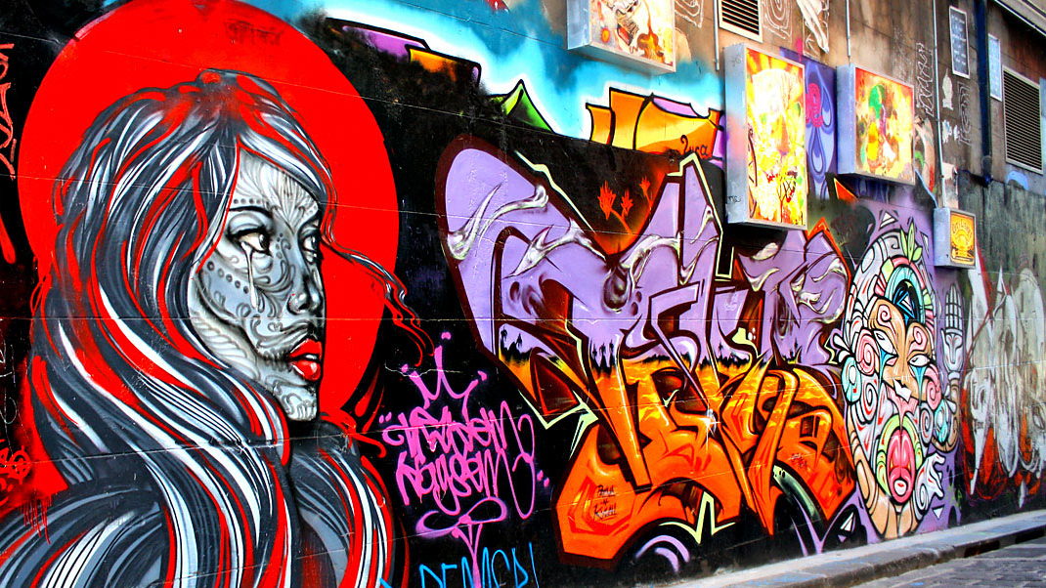
A guided tour of the secret world behind Wikipedia
Dr Thomas Shafee
CC BY SA
Andrew [CC BY-SA]

Slide 2
Who uses Wikipedia?
300M
200M
100M
0
2002
2004
2006
2008
2010
2012
2014
2016
2018
2020
Notes:
How many have looked at Wikipedia in the last week? How about today? About 300M daily pageviews. How many people read my PhD thesis? Yea, so that’s how I got into editing Wikipedia. I’ve now been editing for 6 years, mainly in science topics.

Slide 3
Who uses Wikipedia’s medical pages?
60K
Medical students
40K
Practicing doctors
Research scientists
20K
General
public
0
2002
2004
2006
2008
2010
2012
2014
2016
2018
2020
Fox S, Jones S. Pew Internet. 2009 | Hughes B, Joshi I, Lemonde H, Wareham J. Int J Med Inform 2009 Oct;78(10):645-655 | Allahwala UK, Nadkarni A, Sebaratnam DF. Med Teach 2013 Apr;35(4):337 | Nutzung von Social-Media-Diensten in der Wissenschaft 2017 Goportis – Leibniz-Bibliotheksverbund
Notes:
Actually, you’re not alone in using it…
Also 35% of pharmacists
Also 87% of teachers
Policymakers and Journalists
Wikipedia cited in >400 judicial decisions

Slide 4
Who builds Wikipedia?
60K
40K
20K
0
2002
2004
2006
2008
2010
2012
2014
2016
2018
2020
Notes:
Peak in 2008, but has declined since then (though has started to plateau)
Generally highly educated, but skews heavily male, white, tech background

Slide 5
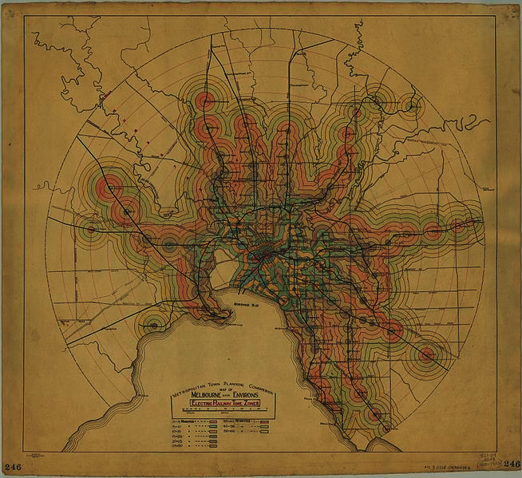
Wikipedia as a city
6M articles (English)
But 50M other pages
Discussion
Policy & Guidelines
Organisation & process
Essays
Advice
Melbourne and Metropolitan Tramways Board [Public domain]
Notes:
If Wikipedia is a city you’ll know many of the main roads, and maybe even the lesser-trafficked roads in your local suburb.
I’m hoping to introduce you to some of the huge number interesting laneways and alleys where the action happens behind the scenes
I’ll be pushing this metaphor pretty far, so when it starts to get tenuous use your imaginations?

Slide 6
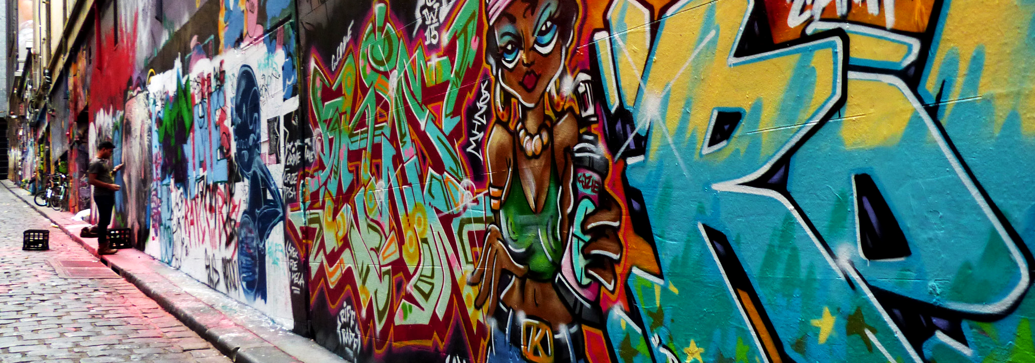
A brief history of terrible ideas
We hate this idea so much we’re leaving and founding Enciclopedia Libre
Hey, maybe we should
put adverts in Wikipedia!
Jimmy Wales 2002 [paraphrased]
Bascially the whole of Spanish
Wikipedia 2002 [paraphrased]
Now we’ve made our point we’ll come back, but sit in the corner and think about what you did
Most of Spanish Wikipedia
2004-2006 [paraphrased]
Bernard Spragg [Public domain]
Notes:
Having said that Wikipedia is widely used, it hasn’t always been this way, and there’ve definitely been a few wrong turns. One of the early fights was over funding and independence.

Slide 7
A brief history of terrible ideas
Everyone has a mascot.
We should have a mascot.
Some Wikipedians 2003 [paraphrased]
Some more Wikipedians 2004 [paraphrased]
Yes and this is what we have voted for
Stevertigo [CC BY-SA]
Bernard Spragg [Public domain]
Notes:
How many people here remember the Wikipedia mascot? Now you might actually be thinking of one of two mascots. The first…

Slide 8
A brief history of terrible ideas
Pfft, if you’re going for both cute and disquieting…
Other
Wikipedians 2005
[paraphrased]
Some more Wikipedians 2004 [paraphrased]
Yes and this is what we have voted for
Kasuga [CC BY-SA]
Stevertigo [CC BY-SA]
Bernard Spragg [Public domain]
Notes:
To which the anime community said ‘well if it’s cute but also creepy you’re going for, then hold my beer’

Slide 9
A brief history of terrible ideas
Dear god what are we doing, lets never speak of this again
Yet moar
Wikipedians growing sentiment over the next six years [paraphrased]
Pfft, if you’re going for both cute and disquieting…
Other
Wikipedians 2005
[paraphrased]
Some more Wikipedians 2004 [paraphrased]
Yes and this is what we have voted for
Kasuga [CC BY-SA]
Stevertigo [CC BY-SA]
Bernard Spragg [Public domain]
Notes:
To which the anime community said ‘well if it’s cute but also creepy you’re going for, then hold my beet’

Slide 10
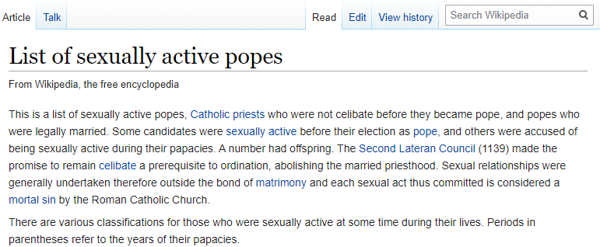
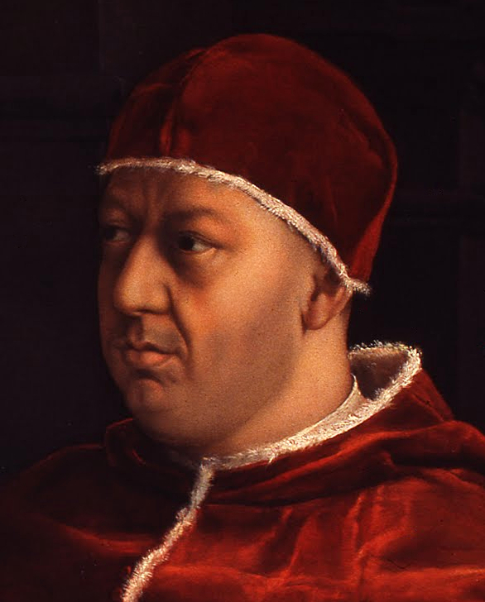
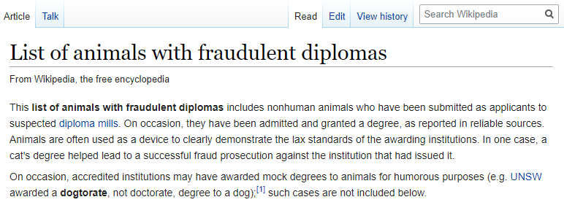
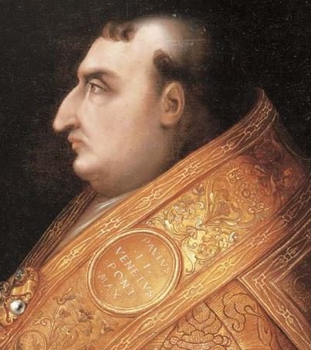
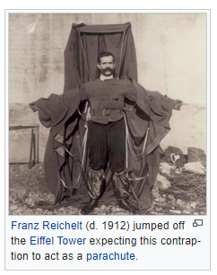
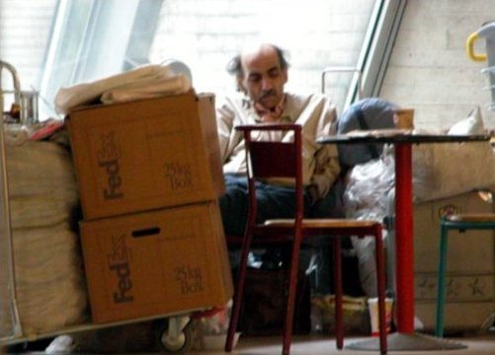
Main road oddities
Raphael [public domain]
Raphael [public domain]
Cristofano dell'Altissimo
[public domain]
Unknown [public domain]
Cristofano
dell'Altissimo
[public domain]
Rory Hyde [CC BY-SA]
Titan [public domain]
Saint Martin [CC BY-SA]
Notes:
Some interesting places still exist in mainspace, not quite the alleyways, but definitely the odder parts of the city.
Sadly there are no images of these animals, so to make up for it, here’s a stack of sexy popes.

Slide 11
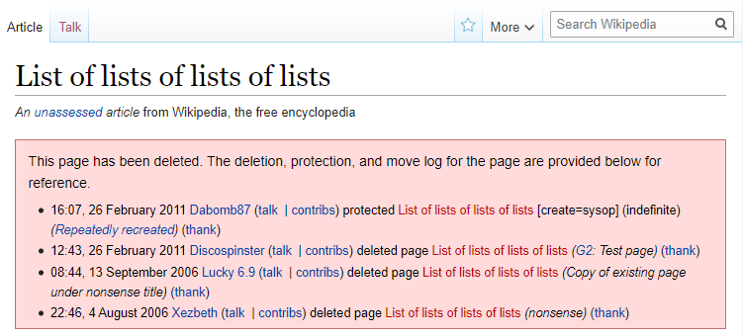
Unusual articles
Raphael [public domain]
Raphael [public domain]
Rory Hyde [CC BY-SA]
Unknown [public domain]
Cristofano dell'Altissimo
[public domain]
Titan [public domain]
Saint Martin [CC BY-SA]
Cristofano
dell'Altissimo
[public domain]
Notes:
Some interesting places still exist in mainspace, not quite the alleyways, but definitely the odder parts of the city

Slide 12
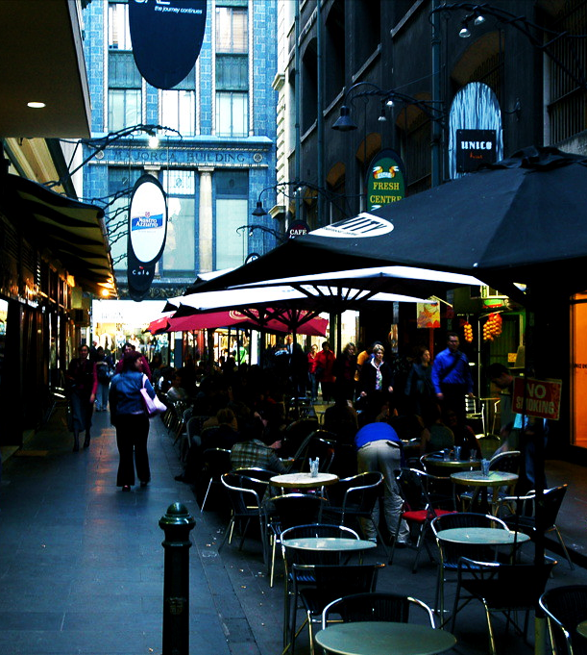
The one joke
ben britten [CC BY]
Notes:
There’s even a single joke (that I know of) that is permitted so I want you to emotionally prepare yourself for this.
Introduced by anon Dec 2012. Debate continued until mid 2015, since which time it has been stable.

Slide 13
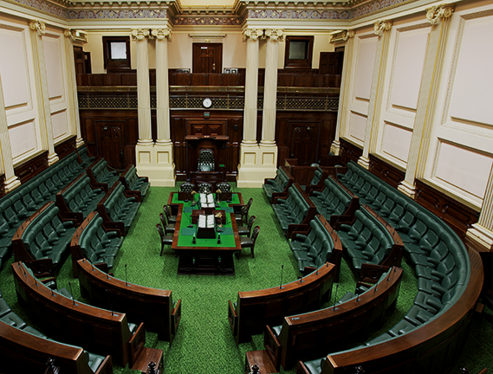
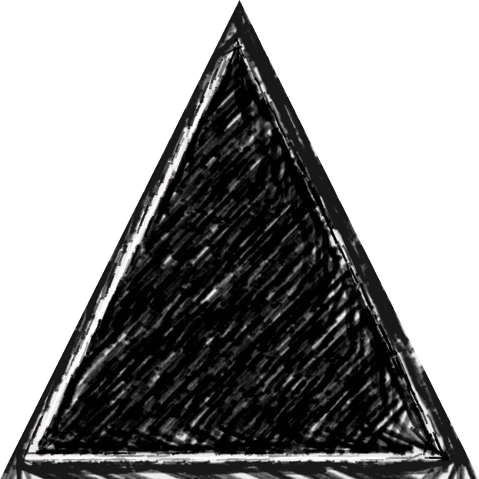
Democracy
Elected committees
Content by consensus
How’s it run?
Democracy
Elected committees
Content by consensus
Bureaucracy
Policies and guidelines
Manual of style
Anarchy
Fully volunteer
Extremely flexible system
No centralised task delegation
Bureaucracy
Policies and guidelines
Manual of style
Anarchy
Fully volunteer
Extremely flexible system
No centralised task delegation
Parliament of
Victoria
[CC BY-SA]
Notes:
So lets go further behind the scenes
Elections for important positions, such as arbitrating disputes
Main policies being verifiability, reliable sources and neutral point of view
But people work on whatever they’re interested in, so coverage is extremely uneven and reflects editor interests

Slide 14
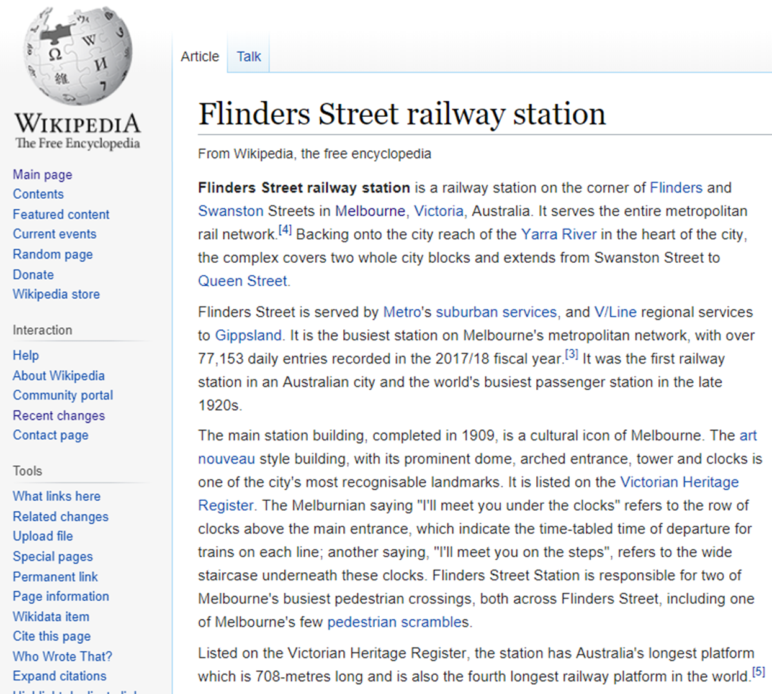
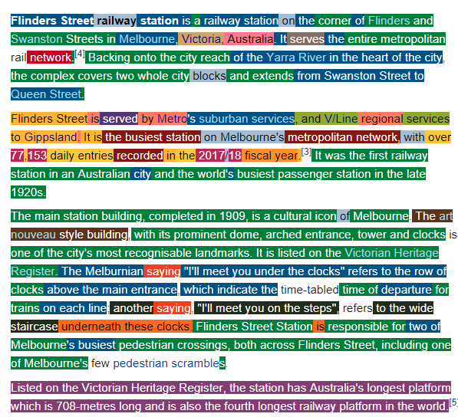
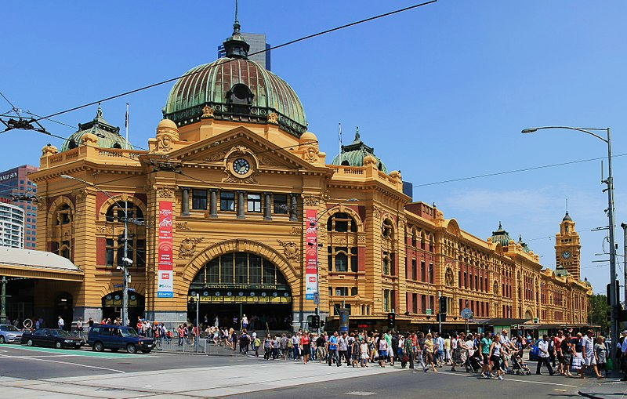
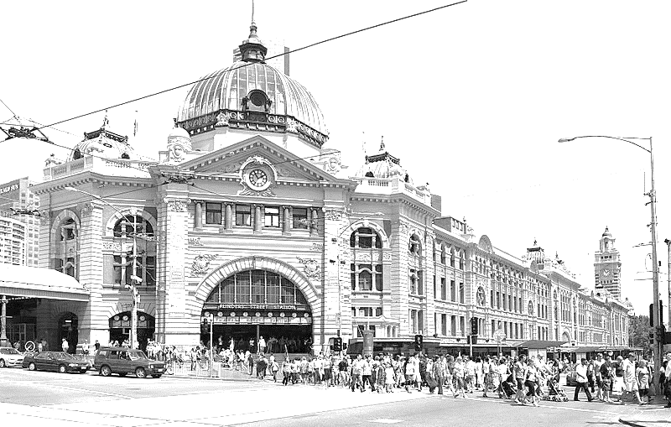
How’s it built?
Fabian Flock et al.
f-squared.org/whovisual/
[MIT license]
ben britten [CC BY]
Notes:
What this means is that every article is a huge collaborative effort by the community

Slide 15
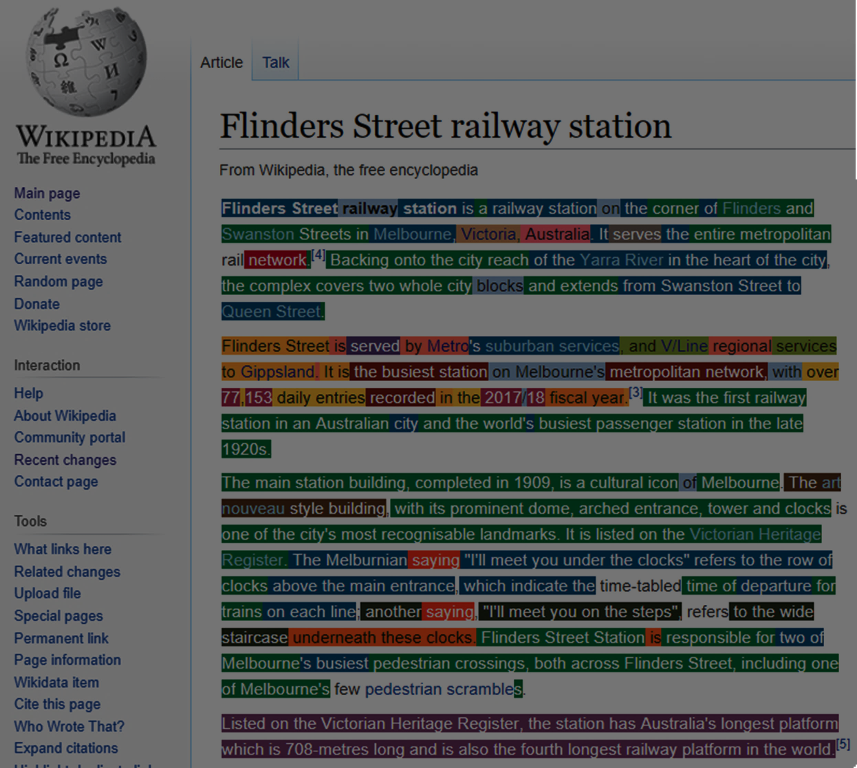
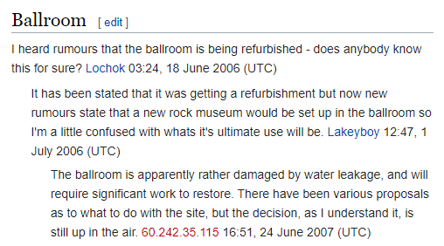
How’s it built?
ben britten [CC BY]
Notes:
Even just a little behind the scenes, on the article talkpages, there’s lots of discussion going on

Slide 16
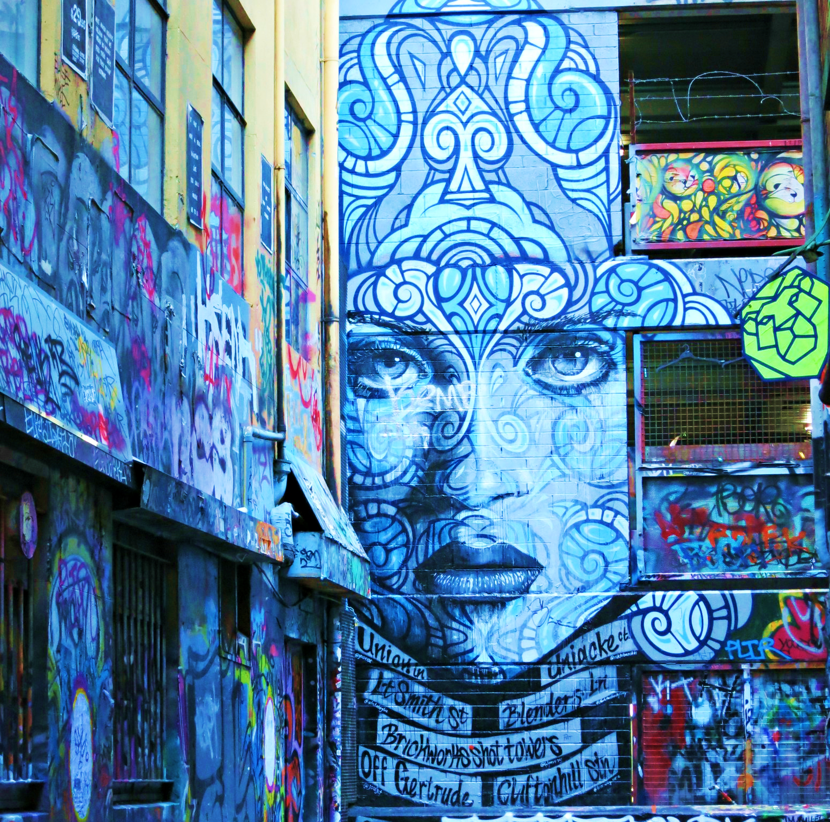
What’s currently going on
1 new edit every 0.5 seconds
S. LaPorte
M. Hashemi
listen.hatnote.com
[custom license]

Slide 17
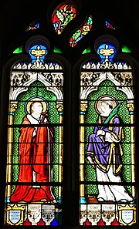
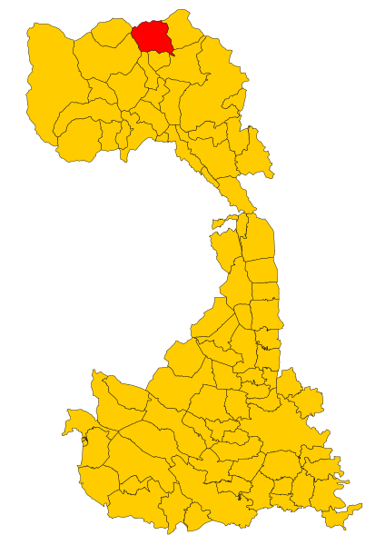
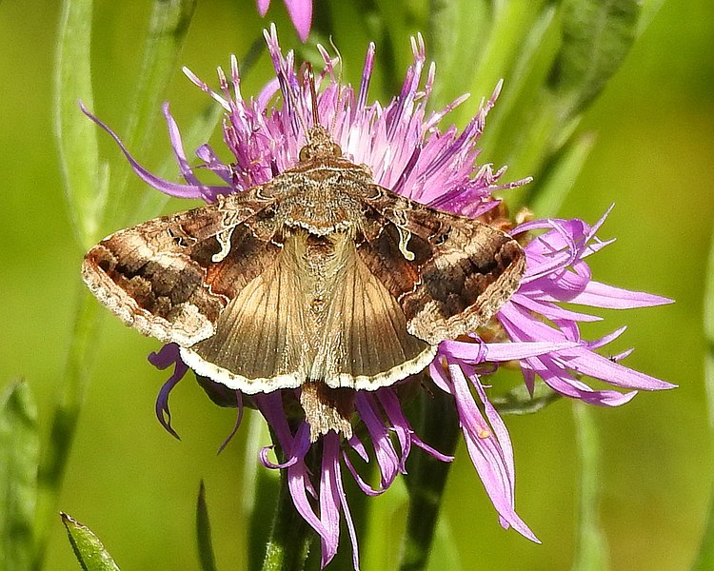
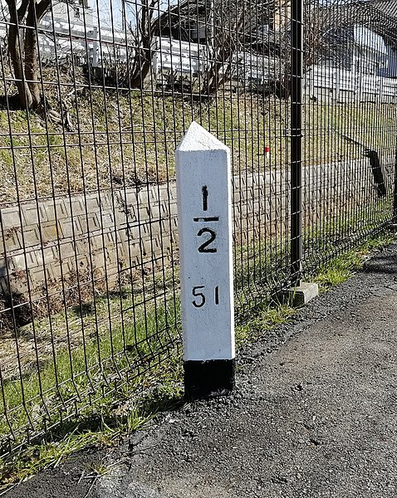
What’s currently going on
Père Igor [CC BY SA]
1 new image every 3 seconds
Parcly Taxel [public domain]
3Pappa3 [CC BY SA]
כורזין11 [CC BY SA]
Åsa Berndtsson [CC BY SA]
HQA02330 [CC BY SA]
Andrea Lai [CC BY]
Notes:
The images added are similarly varied, here is a random selection from the same 1-minute period from the last slide

Slide 18
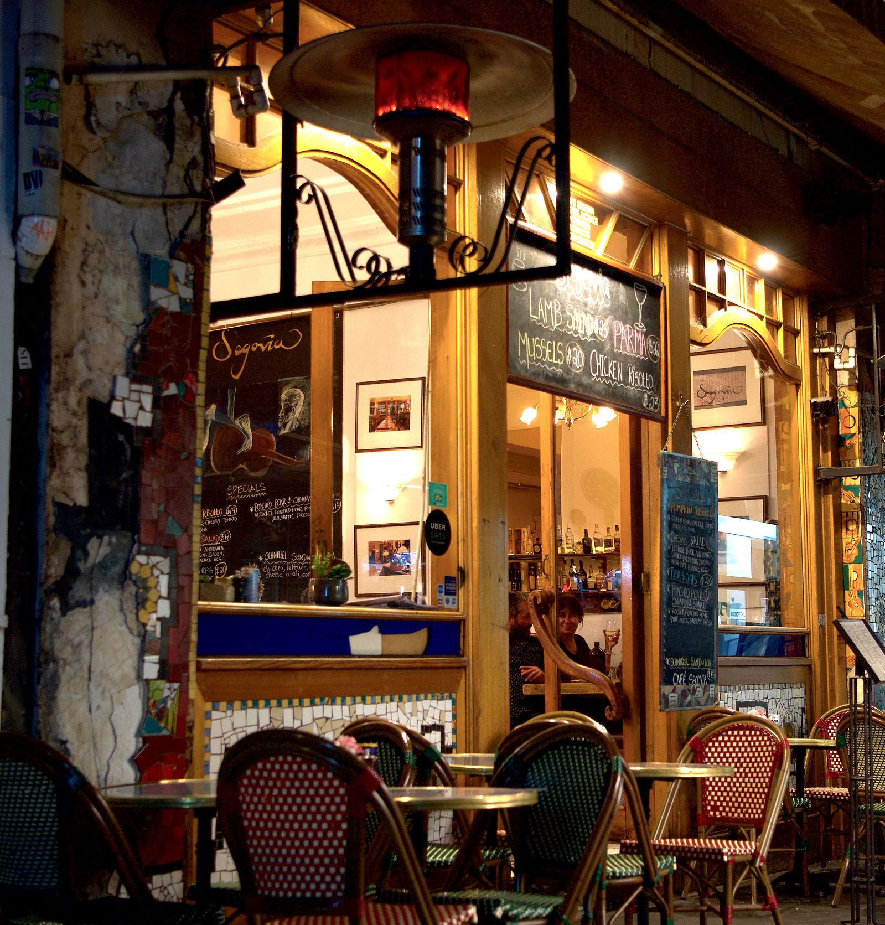
Fighting fake news
Reliable
sources
WikiProjects
Checking,
Checking,
rechecking
Rob Deutscher [CC BY-SA]
Notes:
So with so much activity, how do you prevent a post-truth apocalypse of fake news?

Slide 19
Anti-vandalism
2000 new articles per day,
… of which 70-80% are deleted
Articles for Creation (New drafts)
New page patrol (Recently approved drafts)
Creation
Modification
50 established articles deleted per day
Articles for Deletion
Speedy deletion (1 day)
Proposed deletion (1-4 weeks)
Deletion
Alastair Bennett [CC BY-NC]

Slide 20
Creation
Modification
Deletion
notabilia.net
M. Stefaner
D. Taraborelli
G.L. Ciampaglia
[CC BY-SA]
Notes:
Nicely visualised where right turns are votes to delete and left turns are votes to keep

Slide 21
Anti-vandalism
Bots
(<1 minute)
Machine-learning:
Bayesian neural network
Turnitin: Copyright violation
Bots
(<1 minute)
Human
(<1 hour)
Human
(hours - days)
Quality rating
Machine-learning:
Watching new edits stream
Apprx. 100 at any time
e.g. sentences lacking references
Checking for more subtle errors
Bayesian neural network
Turnitin: Copyright violation
Creation
Human
(<1 hour)
Watching new edits stream
Apprx. 10-20 at any time
e.g. sentences lacking citations
Modification
Human
(hours - days)
Quality rating
Fact-checking for more subtle errors
Deletion
Wyatt915 [CC BY-SA]
Alastair Bennett [CC BY-NC]
Notes:
But most of the activity takes place in this middle phase

Slide 22
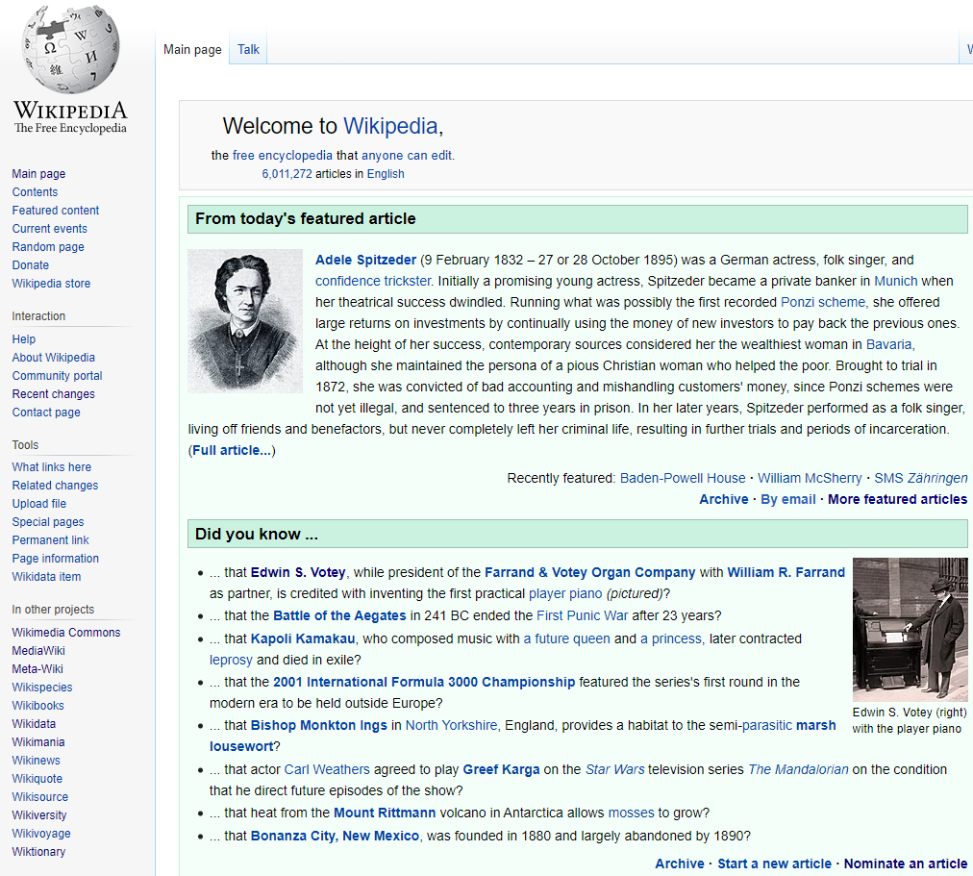
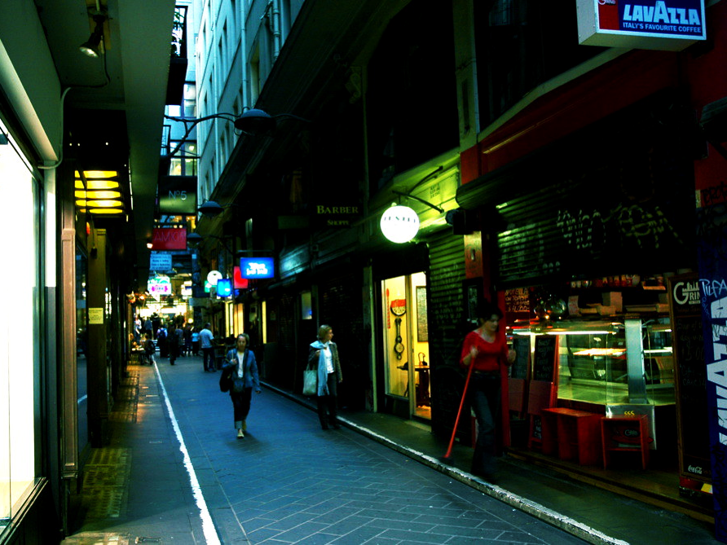
Quality control
Internal review by
5-15 other editors
Top 0.01% of articles
Internal review by
1 other editor
Top 0.06% of articles
Internal review by
1-5 additional editors
ben britten CC BY
Notes:
At the opposite end of the spectrum is the internal review of the best content. Look out for these symbols in the top corner of an article.
Gives you an idea of the articles that appear every day on the Wikipedia front page.

Slide 23
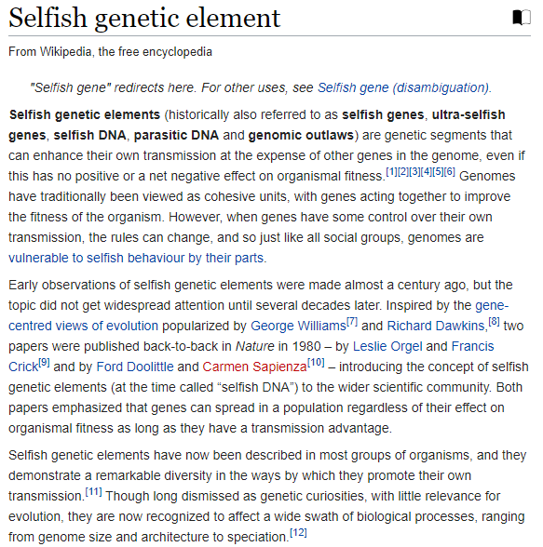
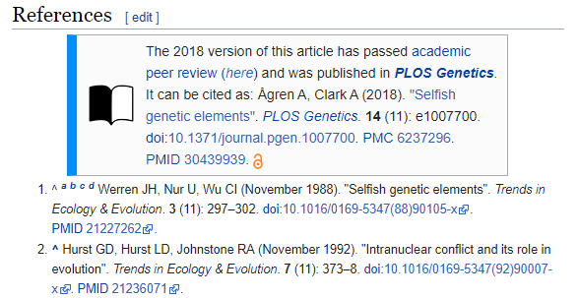
Quality control
WikiJournal
WikiJournal
WikiJournal
WikiJournal
ben britten CC BY
Notes:
There are now even mechanisms for having external experts contribute by writing articles that are peer reviewed by academic journals and published into Wikipedia, or even Wikipedia pages submitted to journals!

Slide 24
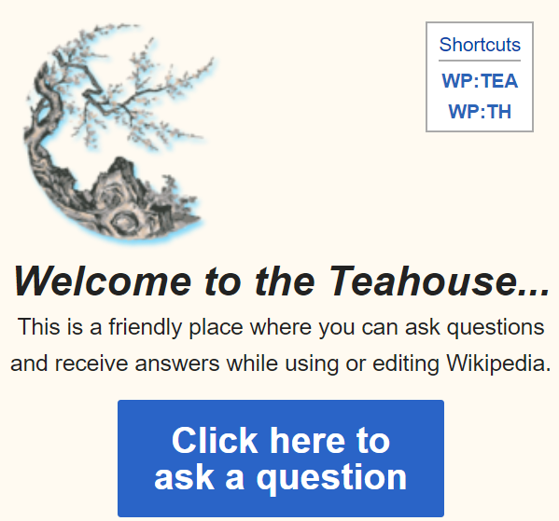
Good places for newcomers
Rob Deutscher
[CC BY]
Notes:
If this all seems intimidatingly complex, don’t worry, there are very friendly places for newcomers to start, meet some of the regulars, try a few test edits.

Slide 25
This presentation
Find me on Wikipedia
Search “User:tshafee”
Sounds of the city: http://listen.hatnote.com/#en
Thomas Shafee [CC BY 4.0]
Notes:
If we’ve got some time for questions I thought I’d leave you with the sounds of the city on in the background.

